Slide 1
South Bank & Waterloo Neighbourhood Planning

Slide 2
12,000 residents
55,000 employees
28m tourists
100m commuters
Contributes £2bn p.a to economy
Facing development on an unprecedented scale
Declining public investment

Slide 3
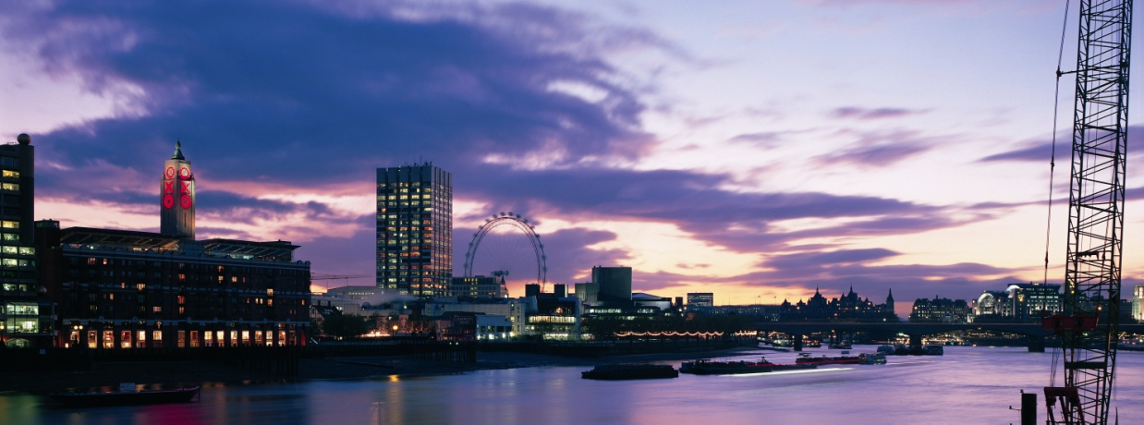
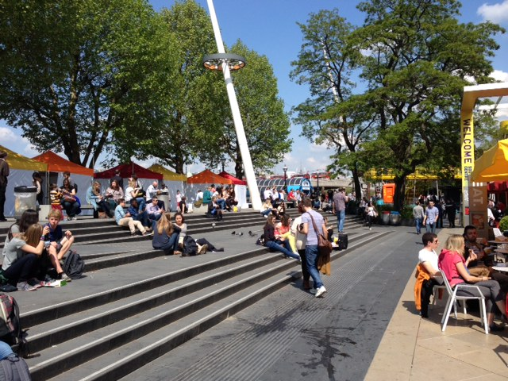
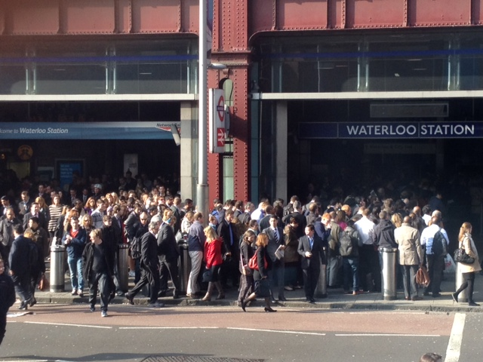
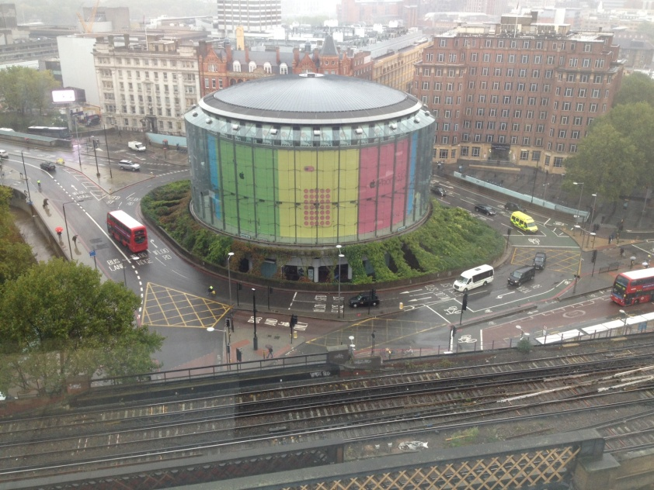

Slide 4
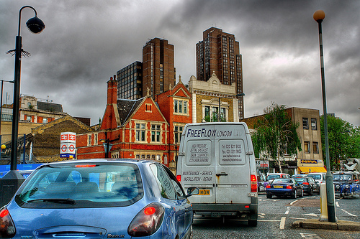
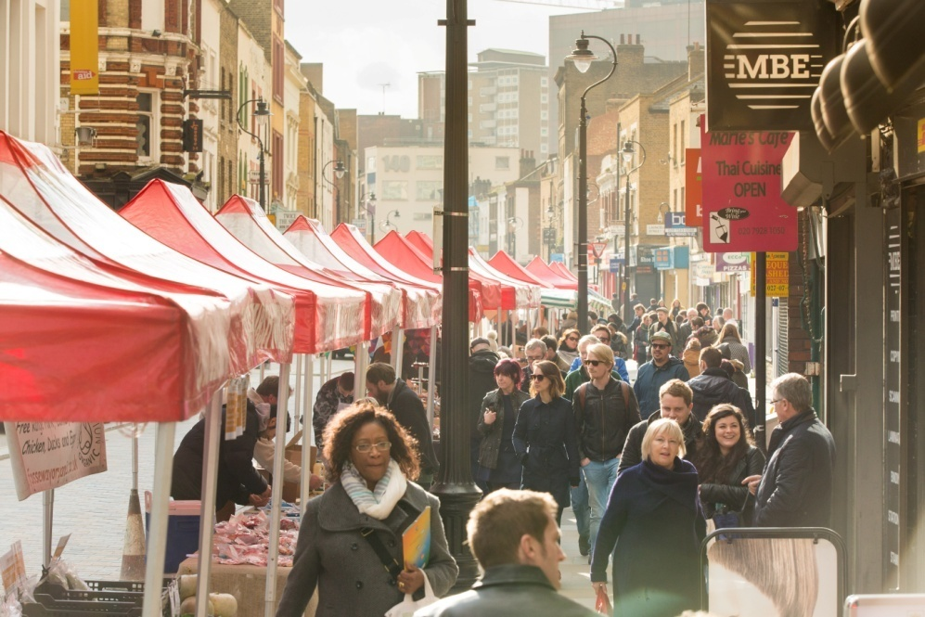
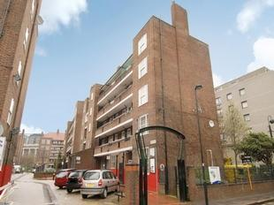

Slide 5
SoWNeighbours
Formed in April 2013
Designated in March 2014
430 Members – 33 in steering group voted through constituent group
Membership categories:
Residents | Representatives of small businesses
Workers | Reps of large public sector organisations
Residents association representatives | Representatives of local third sector orgs
Representatives of large businesses | Ward Councillors

Slide 6
Neighbourhood Plan
Listening – asking questions about what people like and dislike about the area
Distilling – grouping information into broad themes
Developing objectives – general objectives for each theme
Writing policy for the plan itself and taking it to referendum

Slide 7
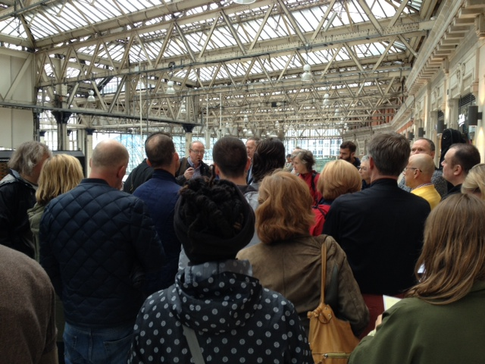
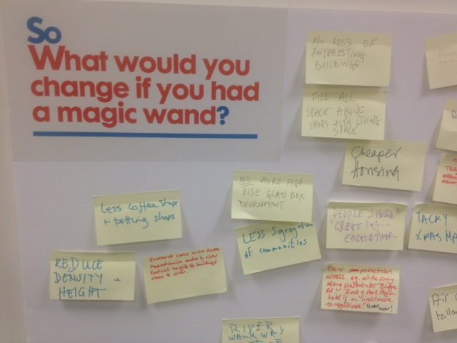
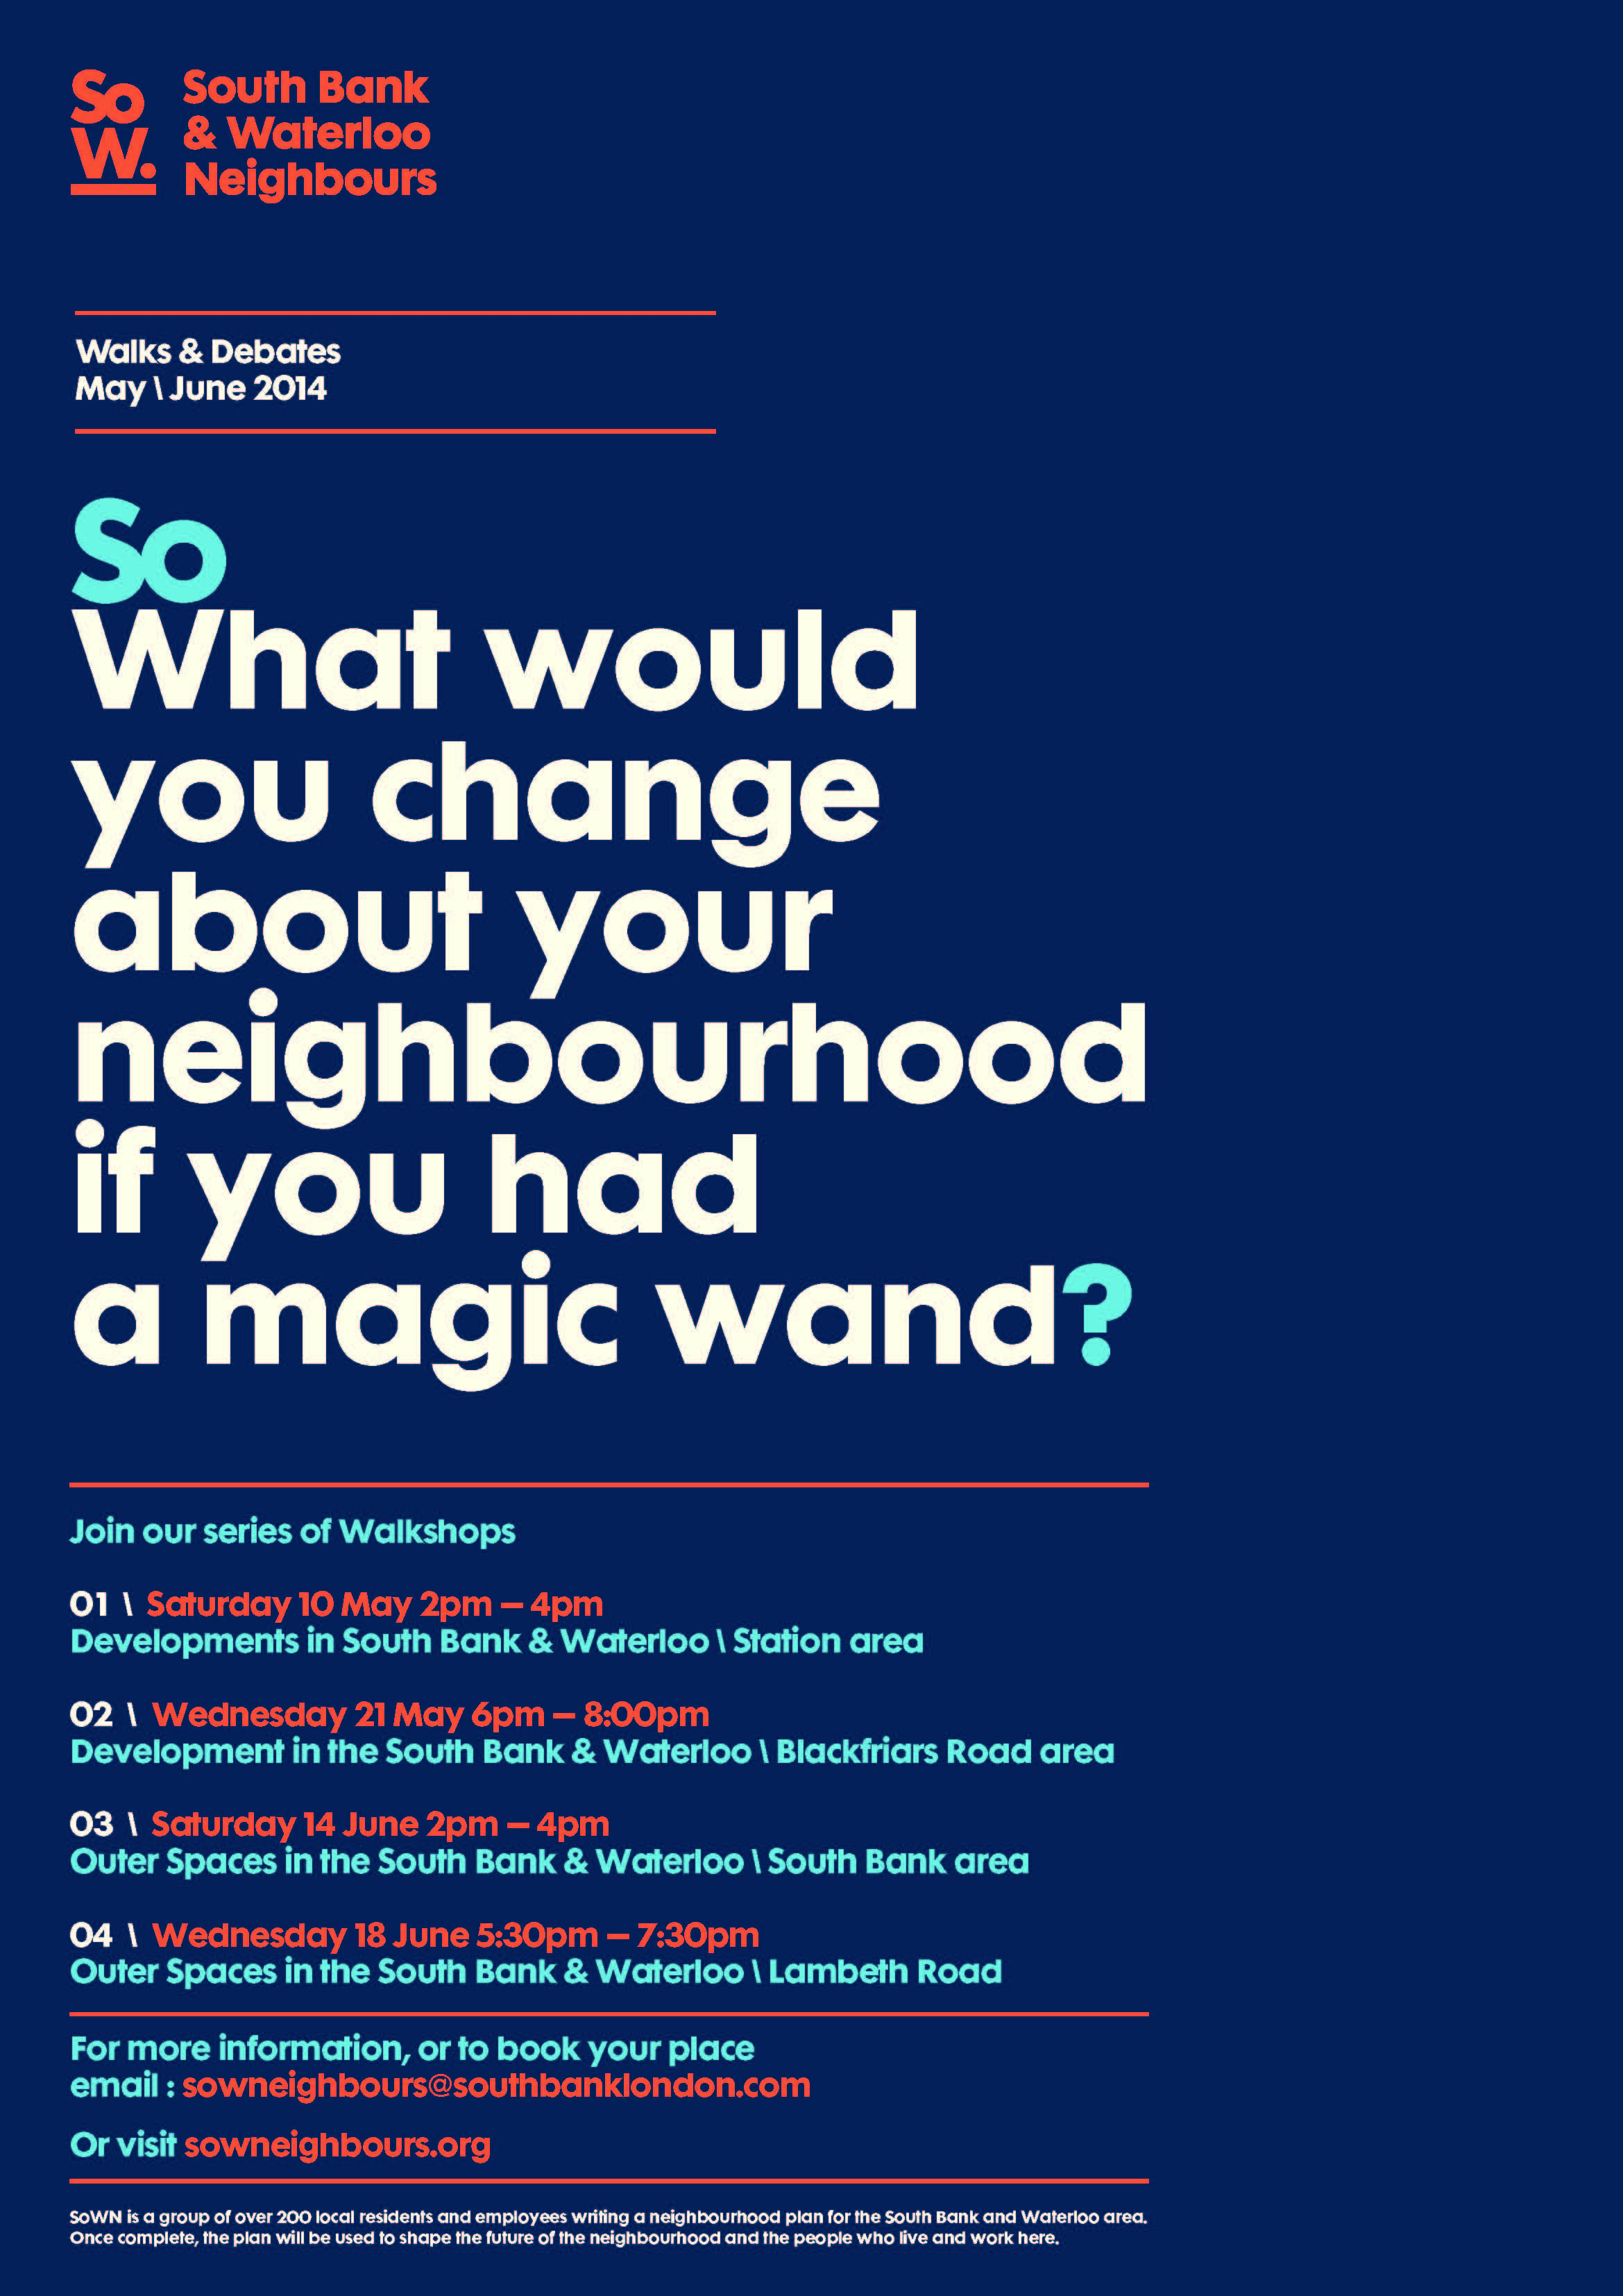
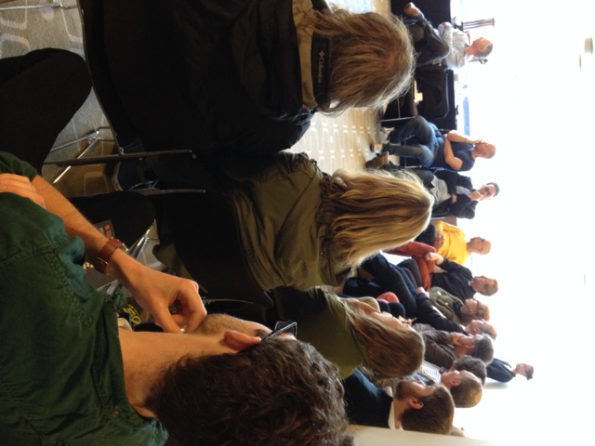
3 burning issues...

Slide 8
Thematic groups
Retail
Housing
Green Infrastructure, open space & air quality
Social Infrastructure
Development management
Streetscape & transport

Slide 9
Why are we doing this?
Decisions about the future of the neighbourhood are taken remotely and with lack of understanding about the needs of local businesses and residents
It’s an opportunity not only to form policy but to fund delivery of that policy through CIL
Brings the business and residential community together
Innovative, local approaches are needed to fix our problems

Slide 10
Five lessons from South Bank & Waterloo
Don’t rely on the support of local authorities
Democracy breeds trust
Build in plenty of time for the big questions
Populous London neighbourhoods = skills
Relationship with local authority is key

Slide 11
What happens next?
Four options:
Incorporate and stay small
Merge community groups into one
Community Land/Development Trust
Parish Council

Slide 12
Benefits of parishing
Community Infrastructure Levy
Maximum local control
Greater power to oversee delivery of neighbourhood plan
Community cohesion
Neighbourhood Forums can make transition more easily than most groups

