Slide 1
Demographics, needs and inequalities for BME communities in Camden
Jonathan O’Sullivan
Camden and Islington Public Health
Notes:
1

Slide 2
Camden
There are about 225,000 residents in the borough
The population is expected to grow by 26,300 (11.7%) to 2026
The borough is relatively young:
  Fewer children and young people (17%)
  More young and middle aged adults – 52% of the population are adults are aged under 45
  Fewer older people (12%)
In the 2011 Census
  34% of residents were from BME communities, compared to 27% in 2001, and
  22% from non-British White Communities (Irish, New World and Eastern European)

Slide 3
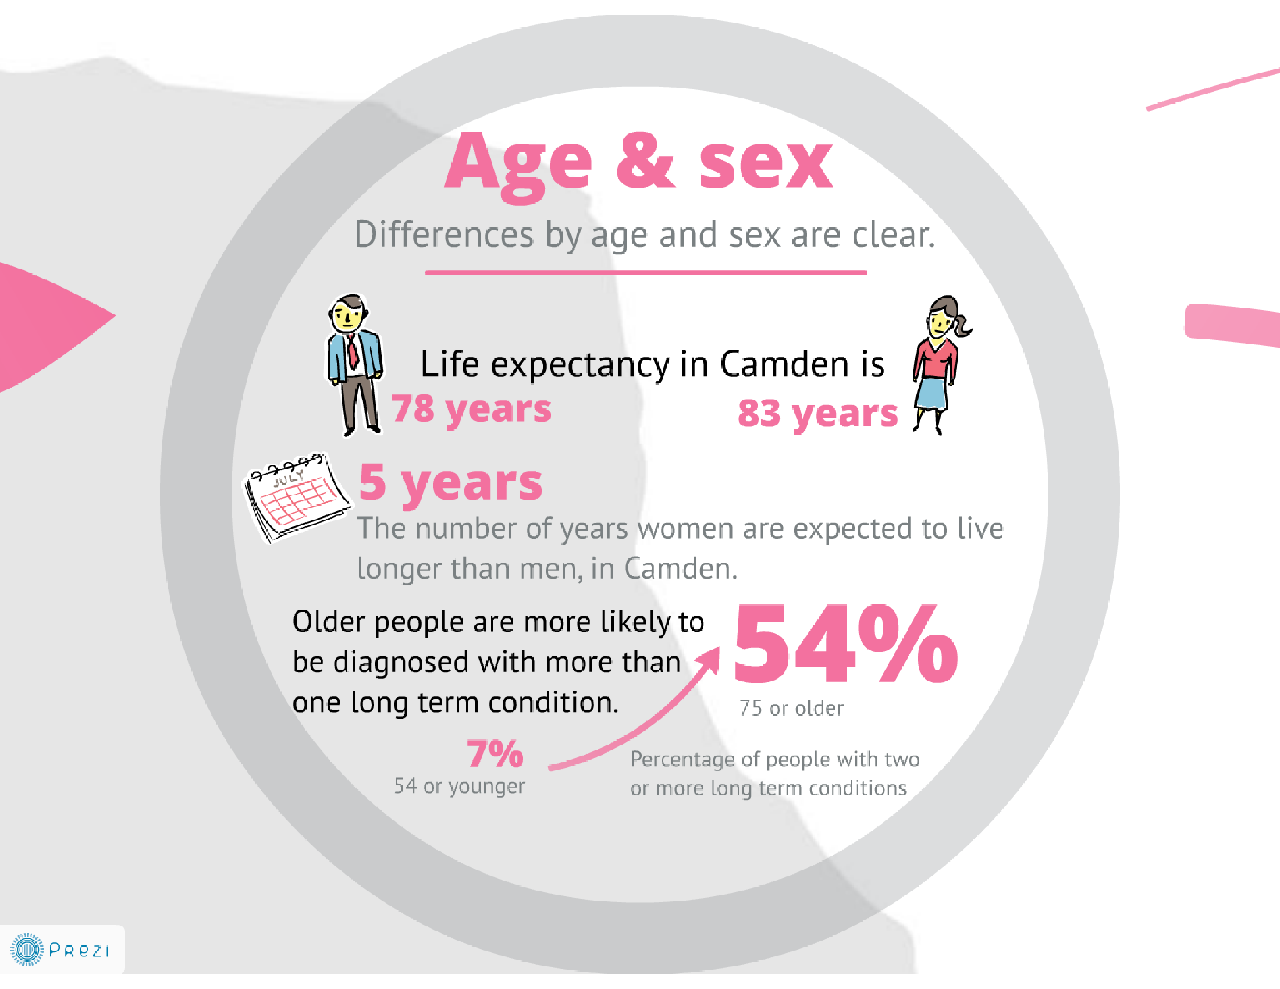
3

Slide 4
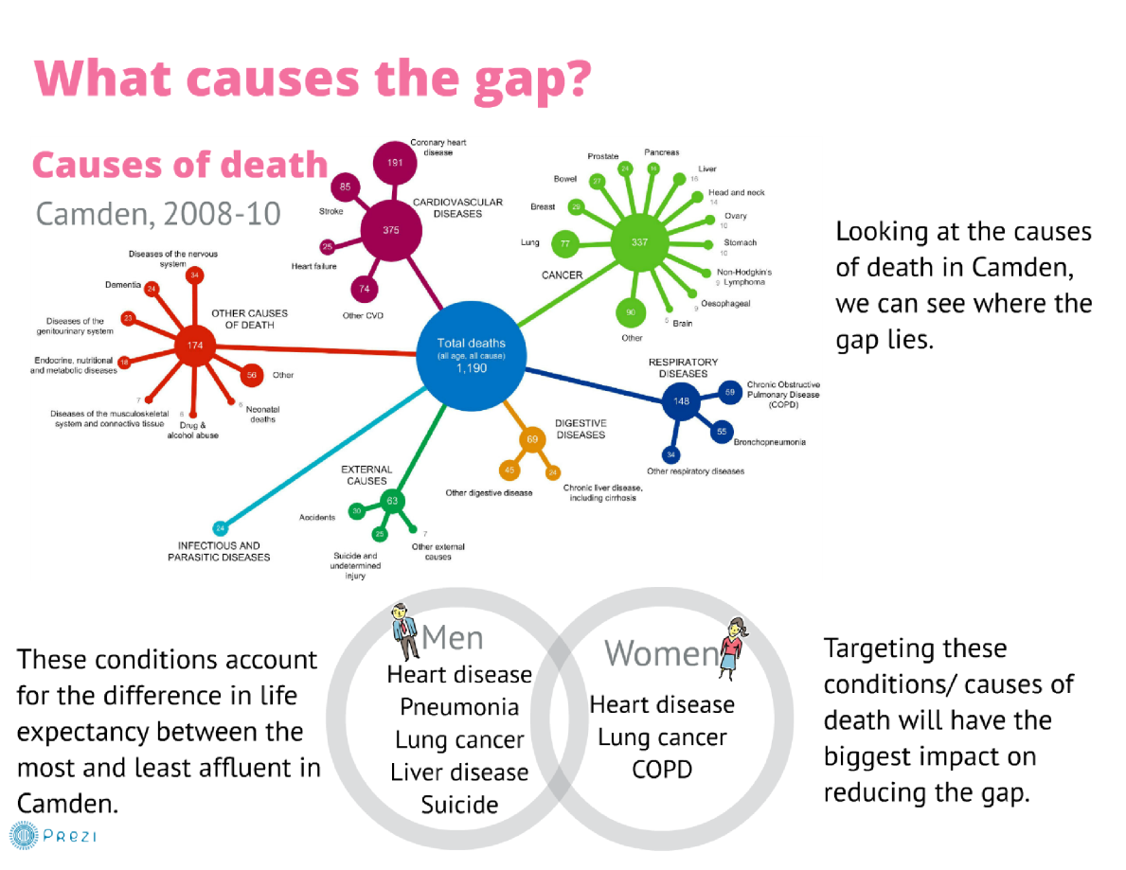
4

Slide 5
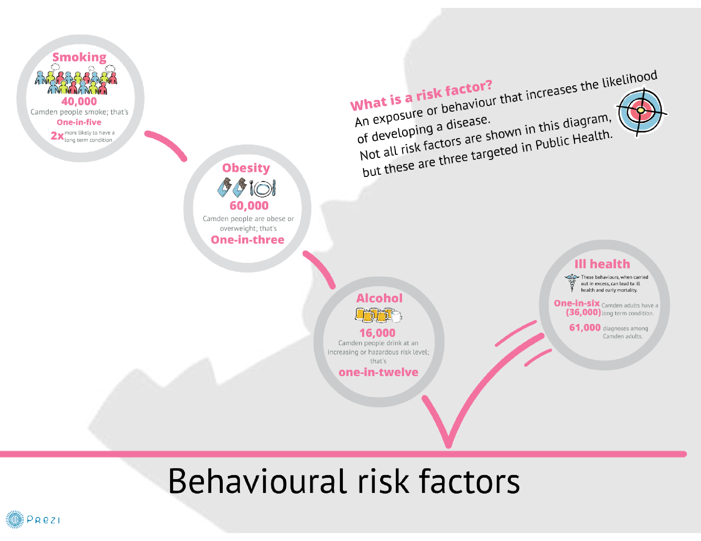
5

Slide 6
Deprivation
24% of residents live within the 20% most deprived areas of England.

Slide 7
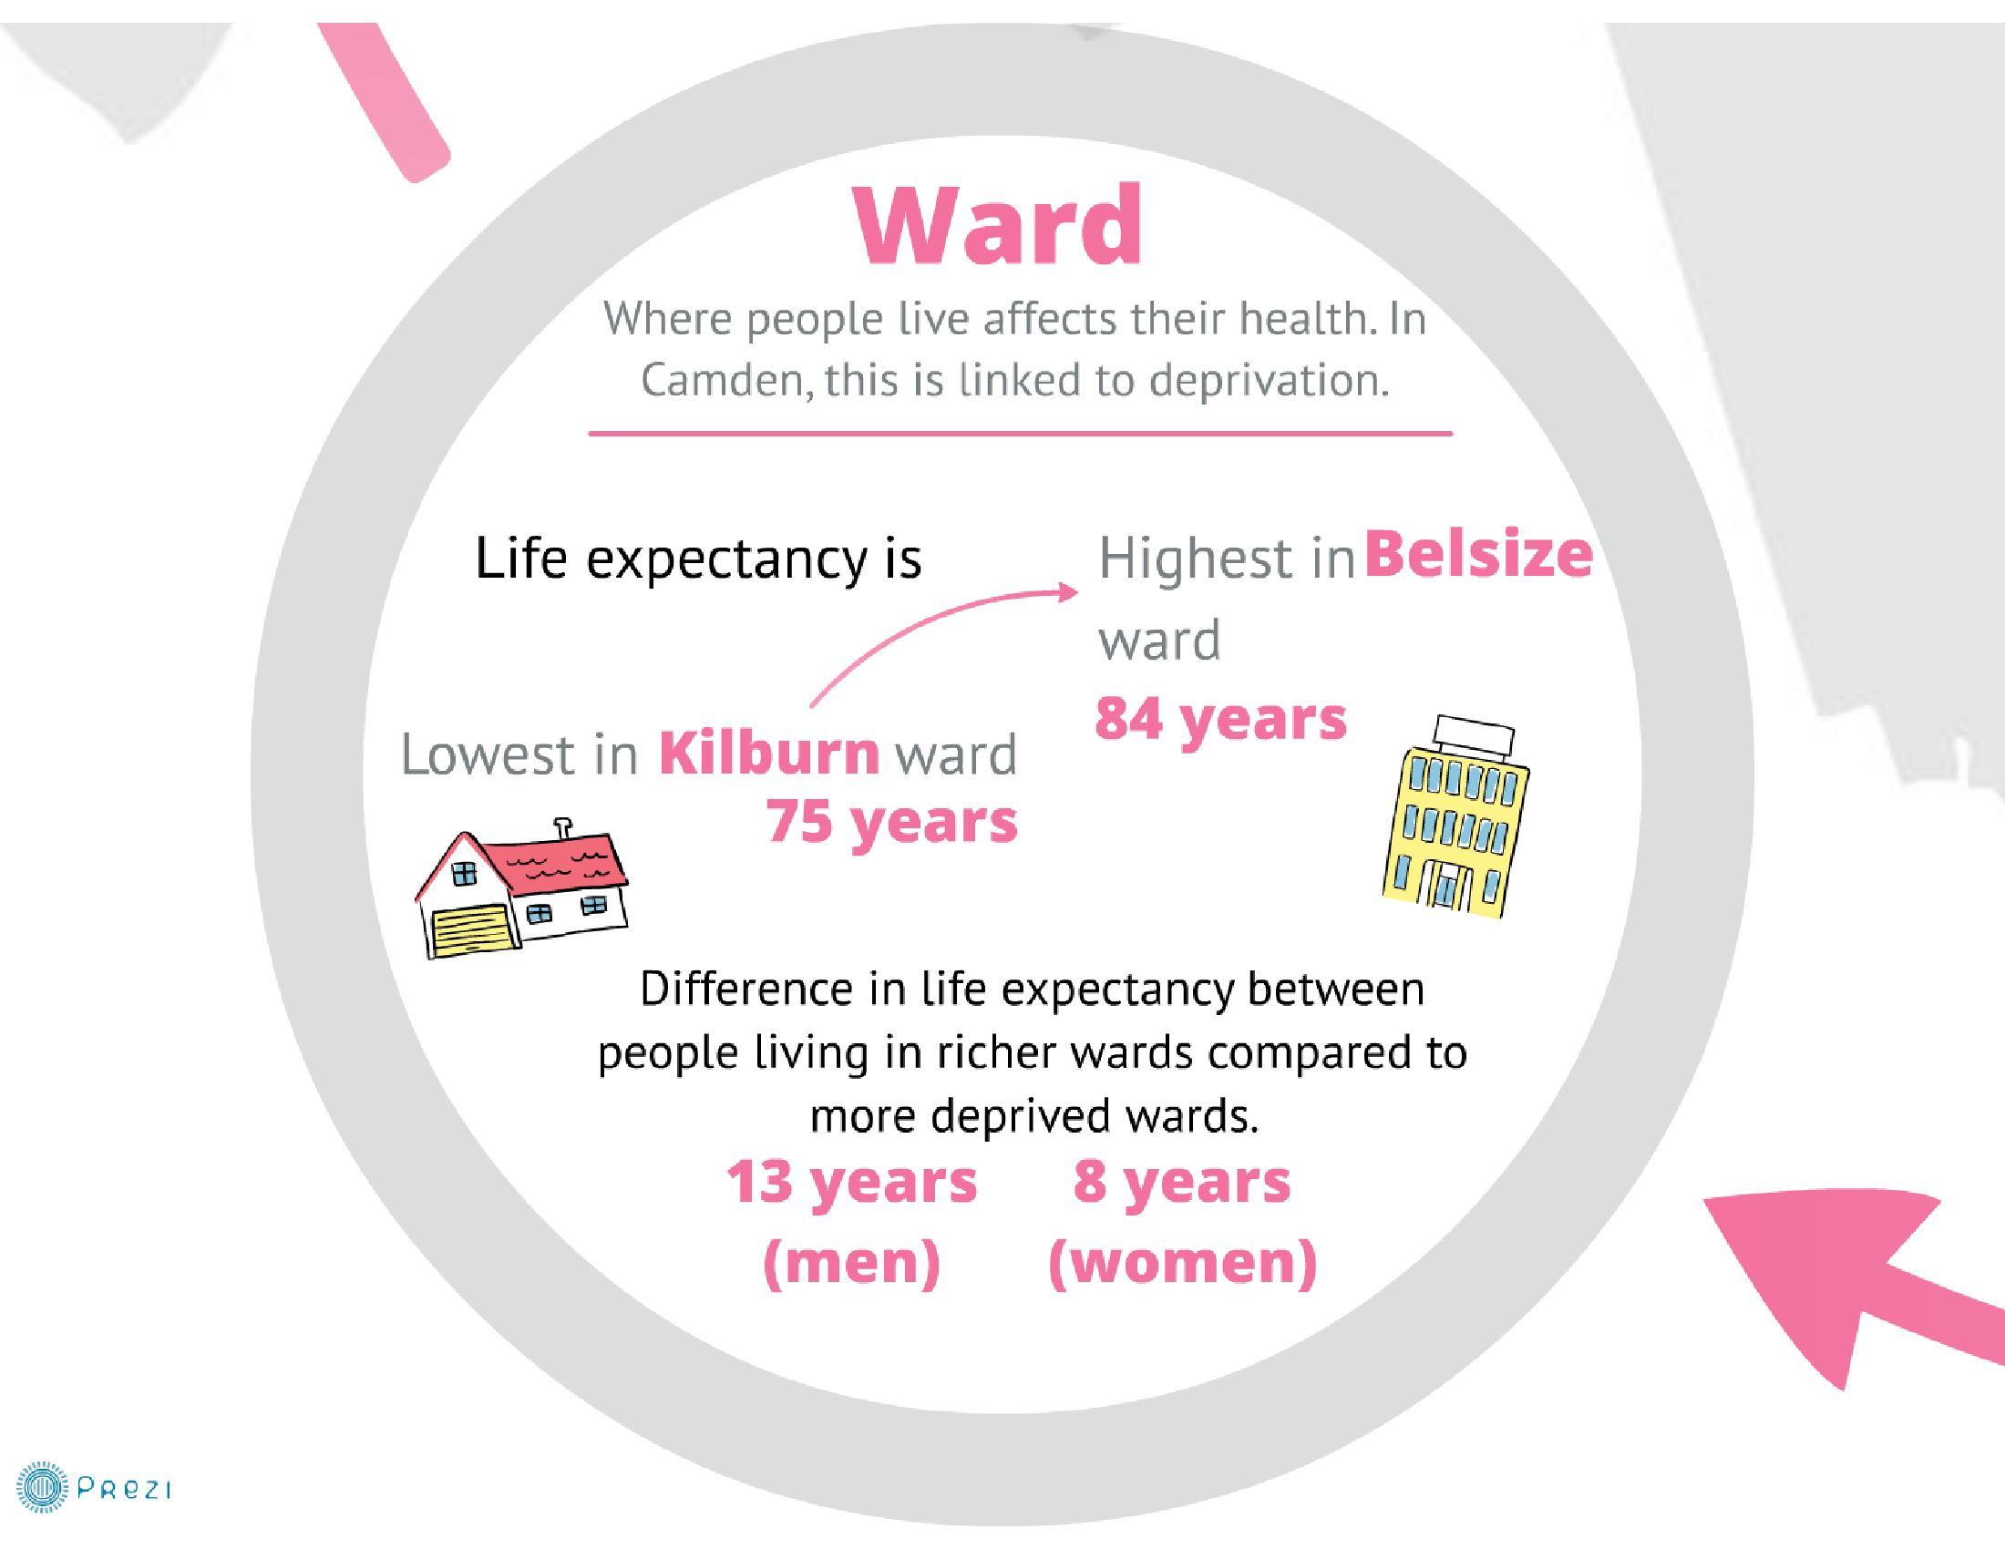
7

Slide 8
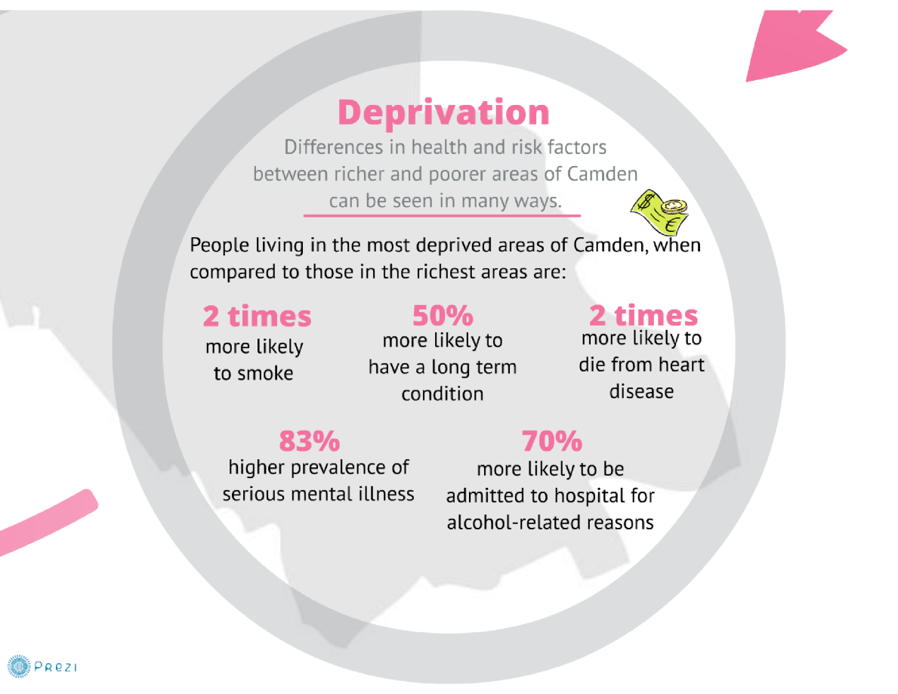
8

Slide 9
Ethnicity by age group
White
Black
Asian
Other
Local coding/ not recorded

Slide 10
Ethnicity by GP practice
Ethnic breakdown of Camden’s registered population²⁰¹²

Slide 11
Language
76%
Of Camden registered patients stated English as their main or only language
3%
of Camden's registered population speak Bengali, the most commonly spoken language, after English, where language data is available.

Slide 12
Mental health conditions in Camden
An estimated 2,310 local children and young people aged 5-16 with mental health conditions, of whom about 80% seen in local services.
An estimated 36,600 adults with common mental health conditions (depression and anxiety) in the borough.
  Diagnosed, unresolved depression in 11,078 Camden GP patients (equivalent to 5.4% of patients, 5th highest in London)
3,496 patients with serious mental illness on GP practice registers (1.38% of the registered population compared to 1.0% in London and 0.8% in England, 3rd highest in London)
874 people with diagnosed dementia (about 67% of expected prevalence)
There are about 17 suicides a year in Camden.

Slide 13
Prevalence- Depression
11,078 people were diagnosed with depression in the 2012-12 QOF.
Highest in middle age, and in women compared to men.
Camden has the fifth highest prevalence (5.4%) of people diagnosed with unresolved depression in London.
Diagnosed depression is higher in women from White and Black or Black British communities; rates are lower in Asian or Asian British and Chinese men and women.
13

Slide 14
Differences by local deprivation: depression
Overall, the percentage of people diagnosed with depression is 37% higher in the most deprived quintile (13%) compared to the least (9%).
14

Slide 15
Prevalence- Serious mental illness (SMI)
3,496 people were diagnosed with SMI in the 2012-13 QOF.
Camden has the third highest prevalence of SMI (1.38%), and is significantly higher than the London and England average.
Average age at diagnosis is 37. On average people have lived with the diagnosis for 12 years, but a quarter have been diagnosed within the last 4 years.
Prevalence is highest in men 45-54 and women 65-74.
Prevalence is highest in Black or Black British communities (4.8% in men and 2.7% in women).
Rates are lower in Asian or Asian British women, Other/Mixed ethnicity women and Chinese men and women
15

Slide 16
Prevalence- Dementia
874 people were diagnosed with dementia in Camden in the 2012-13 QOF.
The prevalence of dementia (0.34%) is significantly lower than the London and England average – this is mainly linked to the relatively younger population in the borough.
There are no significant differences in the diagnosis rates between ethnic groups in Camden.
There are currently fewer older people in BME groups and it can be expected that numbers will increase as BME communities age.
16

Slide 17
Physical health
Mental health conditions are associated with increased risks of poorer physical health outcomes.
Among people with heart disease or diabetes, depression doubles the risk of death.
The impacts become even stronger for people with serious mental illness.
  On average, a young person or young adult diagnosed with schizophrenia or other psychotic illness will die 15 to 20 years earlier than their peers. Causes of death among people with serious mental health conditions are the same as for the general population.
Local analysis shows people with serious mental illness in Camden are 3.9 times more likely to have depression, 3.3 times more likely to have COPD and 2.9 times more likely to have diabetes, compared to the general population.

Slide 18
Mental health awareness and access to help and services
Insight into some key groups in Camden:
Young men with mental health problems, including from BME communities
BME groups, especially Somali people and young Bangladeshi women
Older people
White Irish people
Highlights different perceptions and issues around mental health and access to help and services

Slide 19
Conclusions
This presentation has covered some key demographic and health data
Highlighted BME and mental health through the presentation
Different prevalences and issues for different communities and groups
There are striking inequalities between groups
These include physical health inequalities
As well as quantitative analysis, community engagement and insights are important to develop understanding and responses to mental health needs in Camden

