Slide 1
Covid-19 Risk Assessment Process
Building risk assessments
Service risk assessments
Individual risk assessments
Records all of the practical measures we have put in place to make our buildings Covid secure
Must be completed in consultation with staff and Trade Unions before any of our buildings are re-opened.
Will identify what work activity or situations might expose staff to Covid-19, along with actions required to limit and mitigate exposure as far as is possible
No services will be able to return to work in our buildings until this risk assessment is completed by the Head of Service – and signed off by the relevant DMT.
To be completed by line managers of all staff identified as being at increased risk from Covid-19 before they can return to work in our buildings
This includes demographic factors (such as ethnicity, age and sex); pregnancy; health conditions and disabilities; and personal situations such as mental wellbeing and household members/arrangements.

Slide 2
Building risk assessments
The process will assess potential exposure to Covid-19 – taking into consideration workplace setting and possible transmission through contact with surfaces and people.
It will also set out the appropriate measures that should be put in place to control or eliminate any potential risk of exposure – such as use of PPE, relevant training and hygiene measures.
None of our buildings will re-open until a full risk assessment is completed

Slide 3
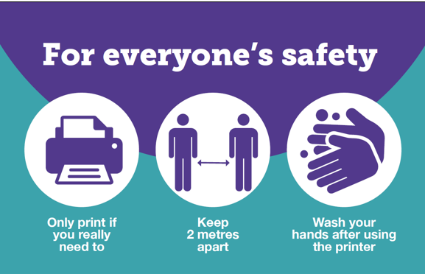
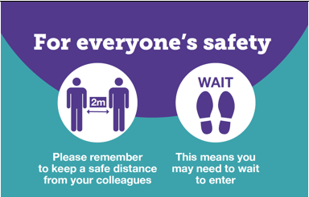
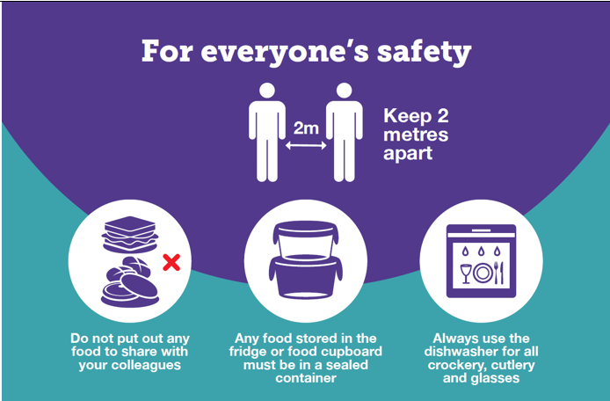
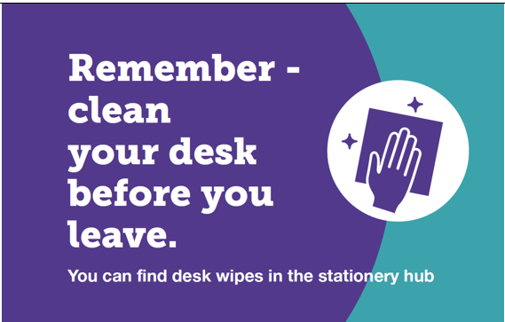
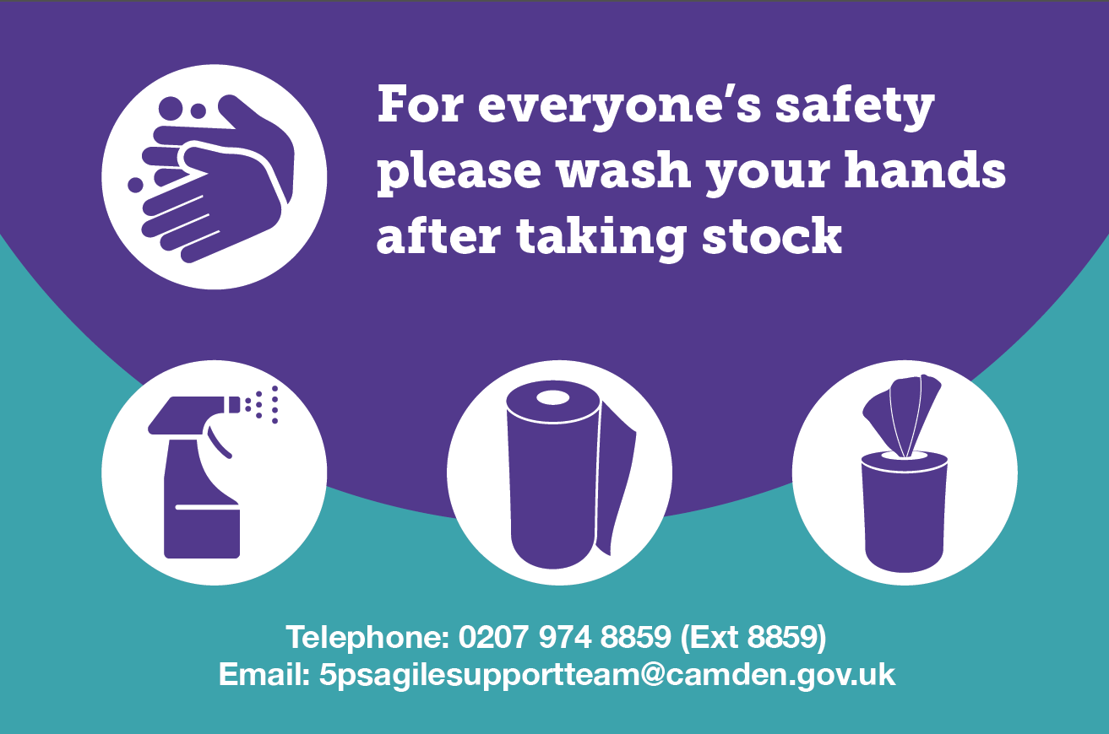
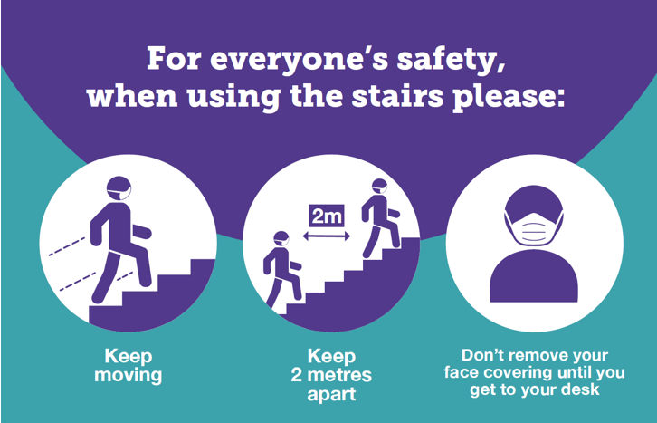
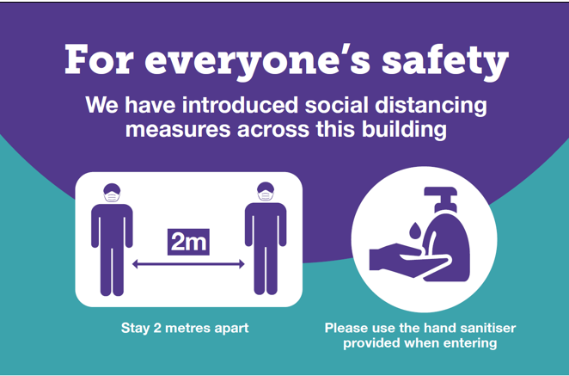
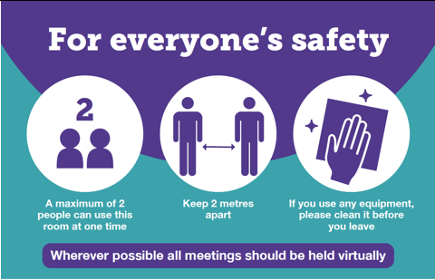
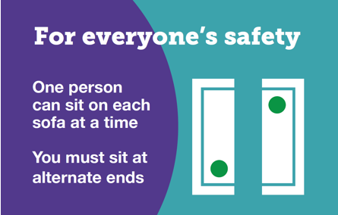
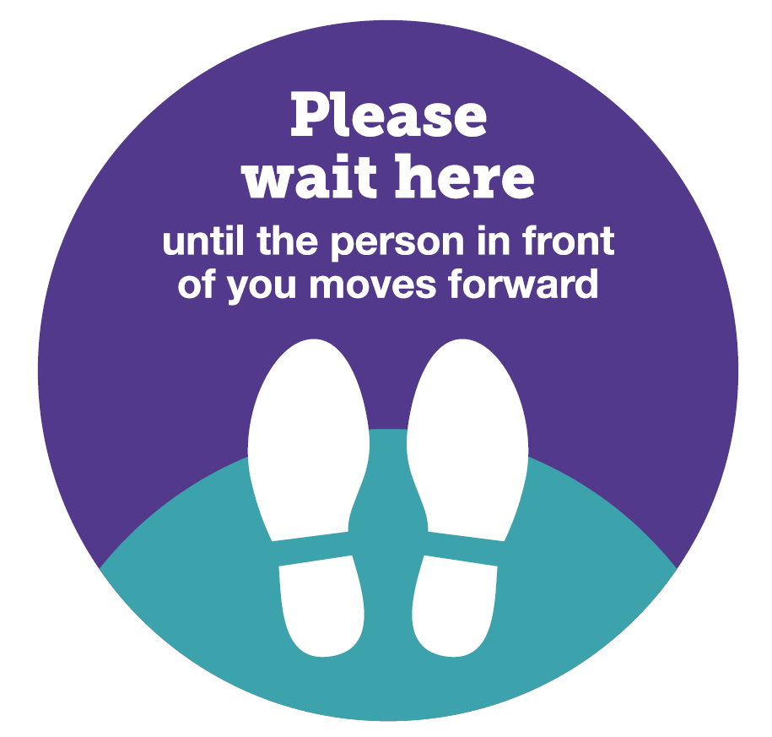
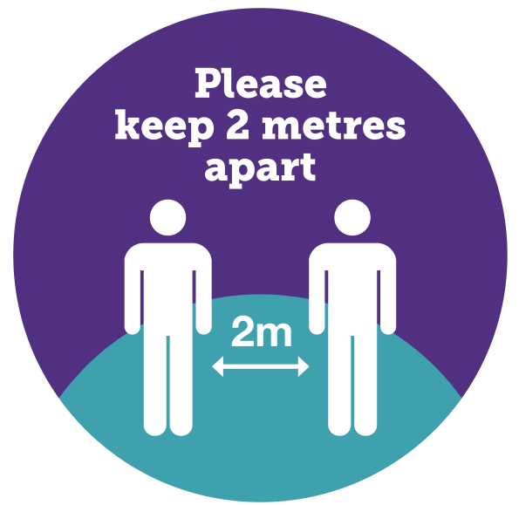
Signage
P – Printer (?) WC – Toilet Door K - Kitchen
“wait sign”
HW – Hand wash ST – Stationery S - Stairs
supplies
E – Entrance D – desks/meeting BO – Break out
Offices
FLOOT MARKINGS- Queuing Social Distancing

Slide 4
Service risk assessments
The process will look at how and where staff could potentially be exposed to Covid-19 as part of their usual work activities – including reviewing the tasks staff within the service are required to complete both in the workplace and out in the community, including if staff are required to travel.
It will also set out the appropriate measures that should be put in place to control or eliminate any potential risk of exposure – such as use of PPE, relevant training and hygiene measures.
No services will be able to return to work in our buildings until a risk assessment is completed and approved by the relevant DMT

Slide 5
Individual risk assessments
You will need to identify and complete a risk assessment for any individuals in your teams who are at increased risk of Covid-19 before they are able to return to work in our buildings.
There are six key factors to consider:
Ethnicity – evidence shows that BAME individuals are being disproportionately affected by Covid-19
Age – people over 70 have been identified as clinically vulnerable
Health conditions and disabilities – people with underlying health conditions and/or those with disabilities which may be the subject of reasonable adjustments
Pregnancy – in particular those who are over 28 weeks or have underlying health conditions
Gender – Working age males are at increased risk compared to females
Personal factors – such as mental wellbeing, vulnerable household members and other household arrangements.
Completed individual risk assessments should be signed off by Directors

