Slide 1
CRM
Voluntary action camden 22 September 2020 Gilbert Pant, WCIT
What is CRM?
Why use one?
What are your options?

Slide 2
What is CRM?
Why use one?
What are your options?
Customer Relationship Manager
Pre-built software package to handle relationships
Contacts, communications, Actions, to do, plans, time, events, reports and history
Personal manager, but multiuser and shared

Slide 3
What is CRM?
Why use one?
What are your options?
It’s better than paper…
Integrated and reduces duplication
It’s already developed (and configured for you)
It’s “free” to use
Choice of vendors

Slide 4
Why should an NfP consider a CRM System?
Better understanding of your stakeholders (service-users, volunteers, clients etc.) and how they engage with your services and activities;
Improved relationship management and communication with stakeholders;
Improving your services through feedback, learning, data intelligence;
Improving the sector by sharing learning, experience and data;
Better tracking of income: grants, donations, contracts, gifts-in-kind etc;
Supports better reporting and impact assessment of projects and activities
Saves time and reduces siloed working.
Notes:
Profile, demographics
Communications, better

Slide 5
The Wider Context
Strategic Plan: Mission, Goals, Timelines
CRM Strategy: clear vision of success, clear executive leadership and high user adoption.
Theory of Change: Monitoring and evaluation framework to show how projects, services & activities lead to impact.

Slide 6
Theory of Change

Slide 7
Processes and Requirements Gathering

Slide 8
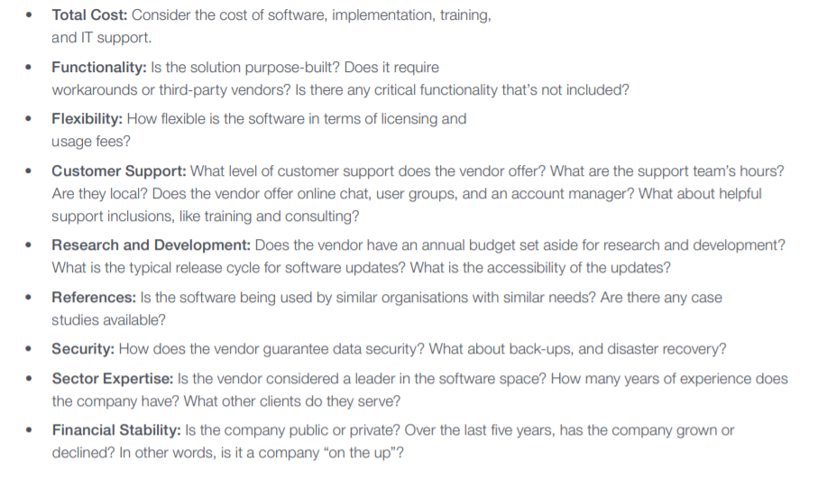
Evaluation Summary

Slide 9
Common Excuses!
Data Migration
Data cleansing
Multiple formats
Timely
Lack of trustee buy-in
not as close to operations as staff so don’t always understand why it’s needed
worried about cost, data protection, strategic risks etc
Research well and present the case
Cost
Expertise
Notes:
Priority data vs desirable

Slide 10
Making the Case
Trustee and Leadership buy-in
Return on Investment
CRM Strategy
“With any new purchase, the return on investment (ROI) will rightly be scrutinised. In order to keep your project on track, you’ll need to be able to effectively answer any questions that your CEO, trustees and others will have regarding the value of your new investment.”

Slide 11
What is CRM?
Why use one?
What are your options?
Many vendors: https://www.softwareadvice.com/crm/ has 773 to choose from!!
Best known: Salesforce, Microsoft Dynamics, Hubspot, Suite CRM and others
Pitfalls: Cost (hidden costs), migration, preparation and knowing requirements, expertise,security of data

Slide 12
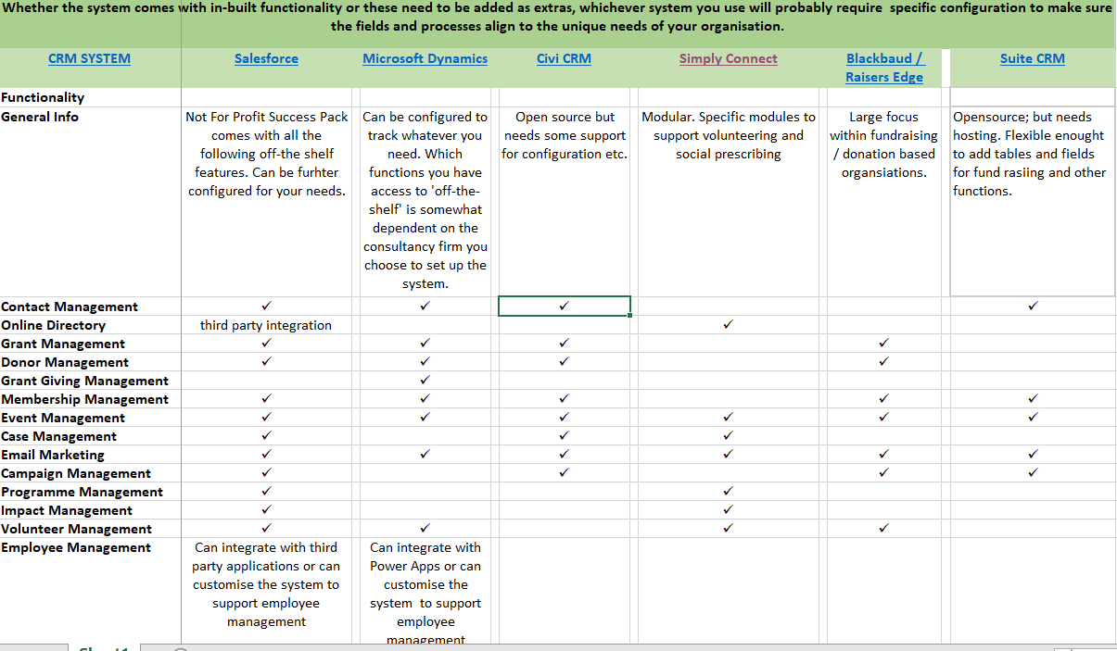

Slide 13
Tips for Choosing Vendors
1. Check review websites and blogs.
Use Google to search broadly for specific requirements.
Always validate this research.
Leverage LinkedIn®.
Research solution partners.
Look for user groups and discussions.
Check company and product pages.
Ask within your own personal and industry networks for recommendations.
Attend industry conferences and associations.
If vendors are serious about your sector, they are likely to participate in the major industry conferences.

Slide 14
Successful Implementation
User engagement: get staff, trustees involved at all stages of planning, testing and implementation.
Data: not all data is valuable. Assess existing data before migrating to new system. Align data capture with Theory of Change.
Regular meetings and communications: keep team members up to date with the migration and implementation process.
Training and Testing: thoroughly test that the system meets your needs and system users know what data to record and how to do this.
Partners: work with an implementation partner if you have a budget or lack of expertise in house.

