Slide 1
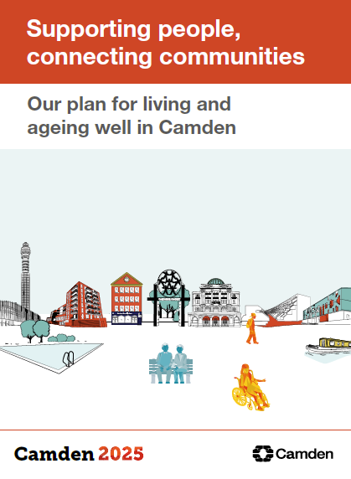
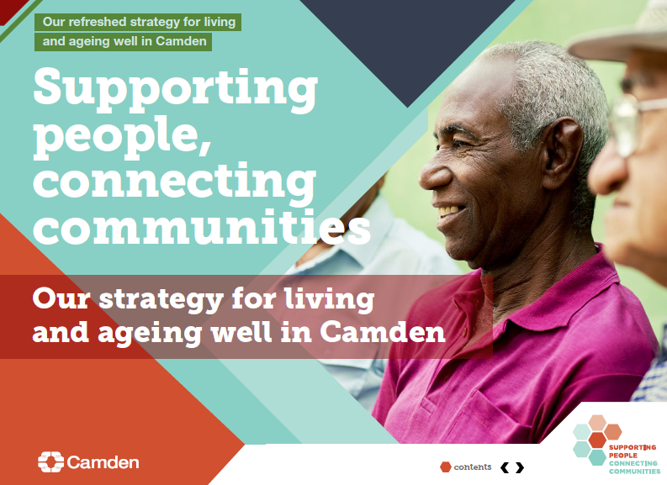
Social Care Neighbourhoods
Neighbourhood | Wards
South | Holborn, Kings Cross, Bloomsbury
Central | Regents Park, St Pancras & Somerstown, Camden Town & Primrose Hill
North East | Cantelowes, Kentish Town, Highgate
North | Belsize, Frognal and Fitzjohns, Gospel Oak, Hampstead Town, Haverstock
West | Fortune Green, Kilburn, West Hampstead, Swiss Cottage
2017 to 2020
Introduced “What Matters” strengths based working
Family group conferencing
Walk the mile (paused)
New contracts for homecare providers
Networking events
2020
Continue to embed What Matters
Early help priority
Hospital discharge
Charlie Ratchford Extra Care
Yearly outcome survey

Slide 2
Integrated working
Camden 2025
Supporting People, Connecting Communities
NHS Long Term Plan
Integrated Care Partnership
We will make Camden the best place to grow, live and age well
To meet this vision, there are 5 focus areas to make Camden a place where all its patients and residents can thrive. These areas of work will tackle the main issues facing the Camden health and care system, including inconsistent care approaches, difficulty in navigation, and duplication of services and activities. The priority focus areas are:
Urgent Community Response
Neighbourhood Working
Community Connectedness
Mental Health, Learning Disabilities and Autism
Children and Young People

