Slide 1
UK General Data Protection Regulation (GDPR) An Introduction PART 2
Voluntary Action Camden (VAC) 28/09/21

Slide 2
Agenda
Introduction
Recap Part 1
Privacy Notice
Subject Access Request (SAR)
Data Protection Impact Assessment (DPIA)
Comfort Break
Incident Response & Data Breach Management
Demonstrating Compliance
Summary/Conclusion
Key Takeaways
Useful Resources
Q & A

Slide 3
Trainer
Certified Information Privacy Professional (CIPP/E)
Certified Information Security Manager (CISM)
Group Data Protection Officer
Data Protection Lead
Extensive experience in Data Protection, Risk & Compliance
Member: International Association of Privacy Professionals
John Adegoke
Data Protection and Privacy Specialist

Slide 4
INTRODUCTIONS
YOUR name
YOUR organisation
YOUR role
Anything else about you? (Optional ☺ )

Slide 5
Recap Part 1
GDPR - Why? Who? Penalties?
Definition of Personal Data – Special Categories
Key Roles – Controller, Processor, DPO, ICO
Data Protection Principles
Lawful basis for Processing
Consent
Your Rights/Data Subject Rights

Slide 6
Privacy Notice
Individuals have the right to be informed about the collection and use of their personal data. This information is typically conveyed in a Privacy Notice
Privacy information must be provided at the time you collect the Personal Data

Slide 7
Privacy Notice
The information you supply about the processing of personal data in your Privacy Notice must be:
concise, transparent, intelligible and easily accessible;
written in clear and plain language, particularly if addressed to a child; and
free of charge

Slide 8
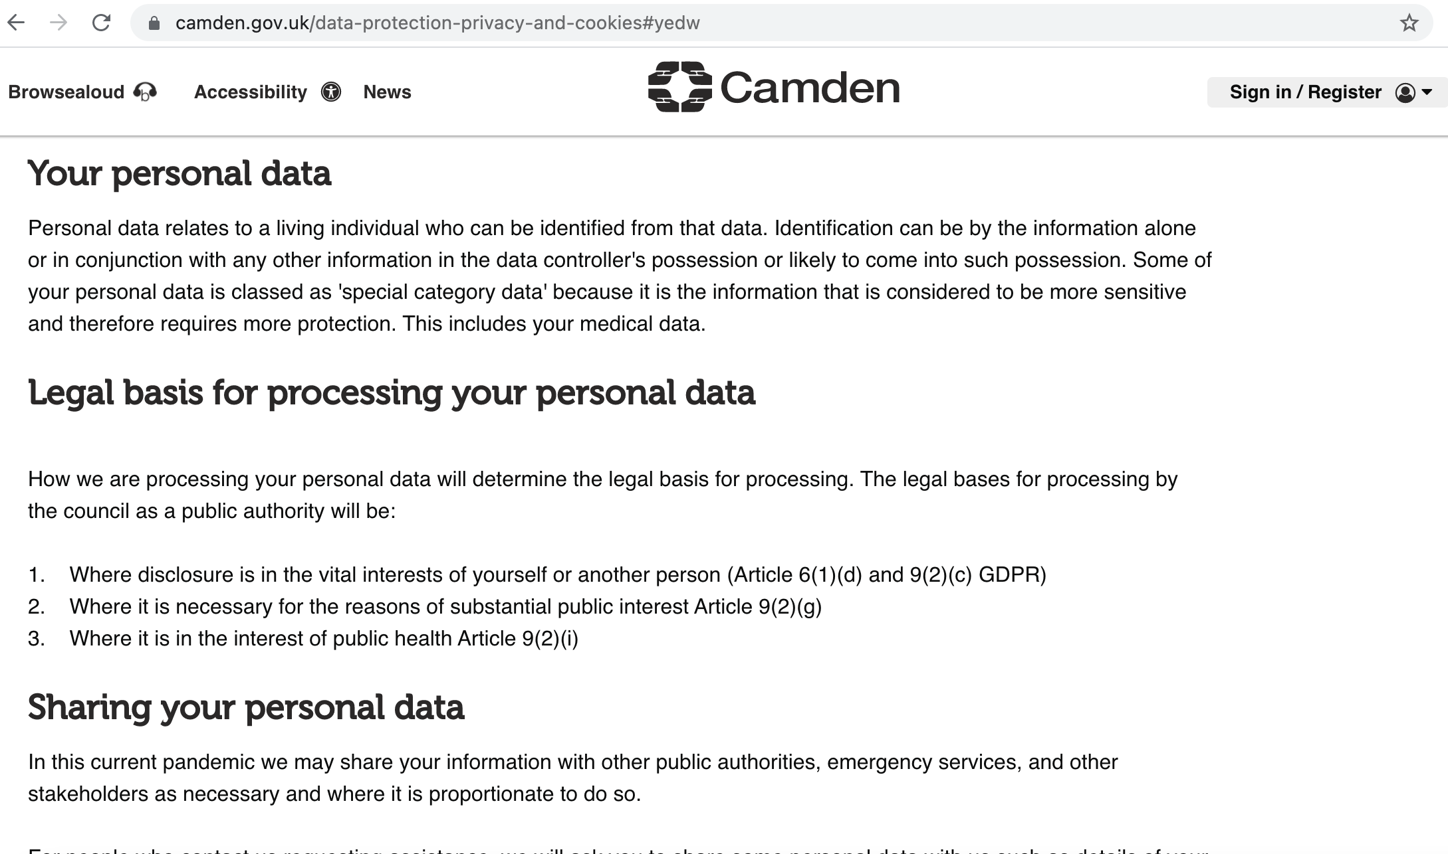
Data Privacy Notice

Slide 9
Subject Access Request (SAR)
The right of Access gives individuals the right to obtain a copy of their personal data as well as other supplementary information
An individual can make a subject access request to you verbally or in writing
An individual is only entitled to their own personal data, and not to information relating to other people

Slide 10
Subject Access Request (SAR)
In addition to a copy of their personal data, you also have to provide individuals with the following information:
the purposes of your processing;
the categories of personal data concerned;
the recipients or categories of recipient you disclose the personal data to;
your retention period for storing the personal data or, where this is not possible, your criteria for determining how long you will store it;
the existence of their right to request rectification, erasure or restriction or to object to such processing;

Slide 11
Subject Access Request (SAR)
the right to lodge a complaint with the ICO;
information about the source of the data, where it was not obtained directly from the individual;
the existence of automated decision-making (including profiling); and
the safeguards you provide if you transfer personal data to a third country or international organisation
You may be providing much of this information already in your privacy notice

Slide 12
Subject Access Request (SAR)
You have a legal responsibility to identify that an individual has made a request to you and handle it accordingly
It is good practice to have a policy for recording details of the requests you receive, particularly those made by telephone or in person
You cannot charge a fee to comply with a subject access request - in most cases

Slide 13
Subject Access Request (SAR)
However, you can charge a “reasonable fee” for the administrative costs of complying with the request if:
it is manifestly unfounded or excessive; or
an individual requests further copies of their data following a recent request

Slide 14
Subject Access Request (SAR)
Finally…
You must comply with a request without undue delay and at the latest within one month of receipt of the request
You can extend the time to respond by a further two months if the request is complex or you have received a number of requests from the individual.

Slide 15
Subject Access Request (SAR)
You should calculate the time limit from the day you receive the request (whether it is a working day or not) until the corresponding calendar date in the next month
If this is not possible because the following month is shorter (and there is no corresponding calendar date), the date for response is the last day of the following month.

Slide 16
Subject Access Request (SAR)
Quiz:
1. You receive a SAR on the 31st of March. April has only 30 days. When is your deadline to respond to the data subject?
2. TRUE or FALSE
You can extend the time taken to respond by a further
3 months from the date of the request

Slide 17
Subject Access Request (SAR)
1
2
Identify a SAR
Validate and verify Identity – photo ID, address etc
3
Deal with requests from 3rd parties or Children
4
Remove exempted data and other peoples data, redact and respond
5
Record in SAR register

Slide 18
Data Protection Impact Assessment (DPIA)
A DPIA is a process designed to help you systematically analyse, identify and minimise the Data Protection Risks of a project or plan – ICO
It is basically a ’Risk Assessment Process’ – taking a risk based approach to assessing activities that involve the processing of personal data

Slide 19
Data Protection Impact Assessment (DPIA)
You must do a DPIA where the processing of personal data is likely to result in a high risk to the rights and freedoms of natural persons
Risk in this context is about the potential for any significant physical, material or non-material harm to individuals
If you decide not to do a DPIA, you must document your reason
Not completing a DPIA when one is needed >> fine of up to £8.5m or 2% of annual turnover, whichever is higher

Slide 20
EXAMPLES OF WHEN A DPIA MAY BE REQUIRED
Procurement of technology, systems, devices or products which involves the processing of personal data
Implementation or development of new processes, technology, systems, devices or products which involve the use of personal data
Collection, retrieval, obtaining, recording or holding of new personal data
The use of a trial period of technology, systems, devices or products which use personal data

Slide 21
Data Protection Impact Assessment (DPIA)
1. Identify the need for the DPIA
7. Integrate the DPIA outcomes into the project
2. Describe the data processing /information flows
6. Record the DPIA outcomes and get sign-off
3. Consult with Stakeholders
5. Identify and Assess Risks; identify solutions/controls
4. Assess Necessity and Proportionality

Slide 22
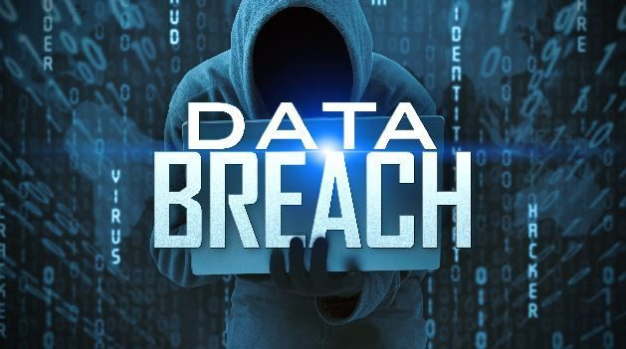
Incident Response & Breach Management
A personal data breach means:
“a breach of security leading to the accidental or unlawful destruction, loss, alteration, unauthorised disclosure of, or access to, personal data transmitted, stored or otherwise processed”
This includes breaches that are the result of
both accidental and deliberate causes

Slide 23
Incident Response & Breach Management
If you suspect a data breach, you must report it asap 24/7
To your Team lead/Manager
Via your internal breach reporting process

Slide 24
Incident Response & Breach Management
If a breach is likely to result in a high risk to the rights and freedom of the individuals:
You must notify –
The Supervisory Authority within 72 hours of becoming aware of the breach (controller)
The affected individuals, without undue delay (controller)
The Controller, without undue delay (processor)

Slide 25
Breach Quiz
Which of the following is NOT a data breach?
Loss of a Laptop containing personal data
Receiving a list of customer contact details from a retailer in error, by email
Processing personal data collected with consent from your website
Keeping the list of your members contact
details in an unlocked cabinet in your office

Slide 26
Demonstrating Compliance
7th Principle: The organisation shall be responsible for and be able to demonstrate compliance with the Principles of the UK GDPR (Accountability)
Evidence:
Lawful basis and transparency for all personal data processing
- e.g Consent; Privacy Notice
Technical and Organisational measures
- IT Controls; Data Protection Policy; Information Security Policy; SAR Policy and Procedure etc

Slide 27
Demonstrating Compliance
3. Data Protection Impact Assessments (DPIA)
4. Record of Processing Activities (RoPA)
5. Training & Awareness
6. Processes to uphold Privacy rights - SAR; Breach Management; etc
7. Keep a data breach register
8. Appoint a DPO, where required (otherwise designate someone to be responsible for Data Protection)

Slide 28
In Conclusion
The GDPR is the legal framework that sets guidelines and rules for the collection and processing of personal data of individuals within the UK
We all have a duty to protect the personal data that we collect and use
GDPR compliance is EVERYONES responsibility!

Slide 29
Key Takeaways
Think security every time you handle personal data
Know where and who to go to for assistance
Do not collect personal data that you do not need
Recognise when there is a subject access request
Delete personal data when no longer needed
Report data breaches asap
Do not share personal data without checking that you are allowed to do so

Slide 30
Useful Resources
Information Commissioner’s Office (ICO)
www.ico.org.uk
Fundraising and Data Protection - ICO
https://ico.org.uk/for-organisations/fundraising-and-data-protection/
Direct Marketing Guidelines: - ICO
https://ico.org.uk/media/for- organisations/documents/1555/direct-marketing-guidance.pdf
4. Charity Digital
www.charitydigital.org.uk
5. Voluntary Action Camden (VAC)
https://vac.org.uk/

Slide 31
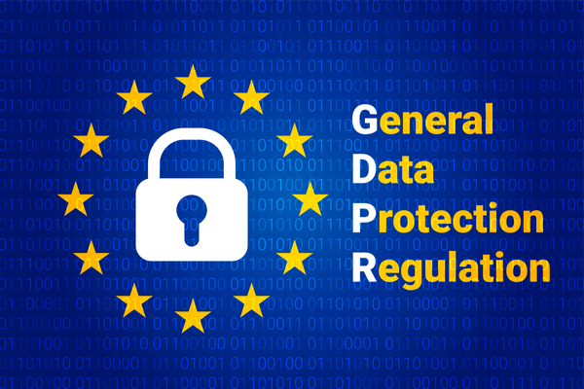
THANK YOU
Q & A

