Slide 1
COVID-19 Vaccination uptake
10th of January 2022
Camden Public Health

Slide 2
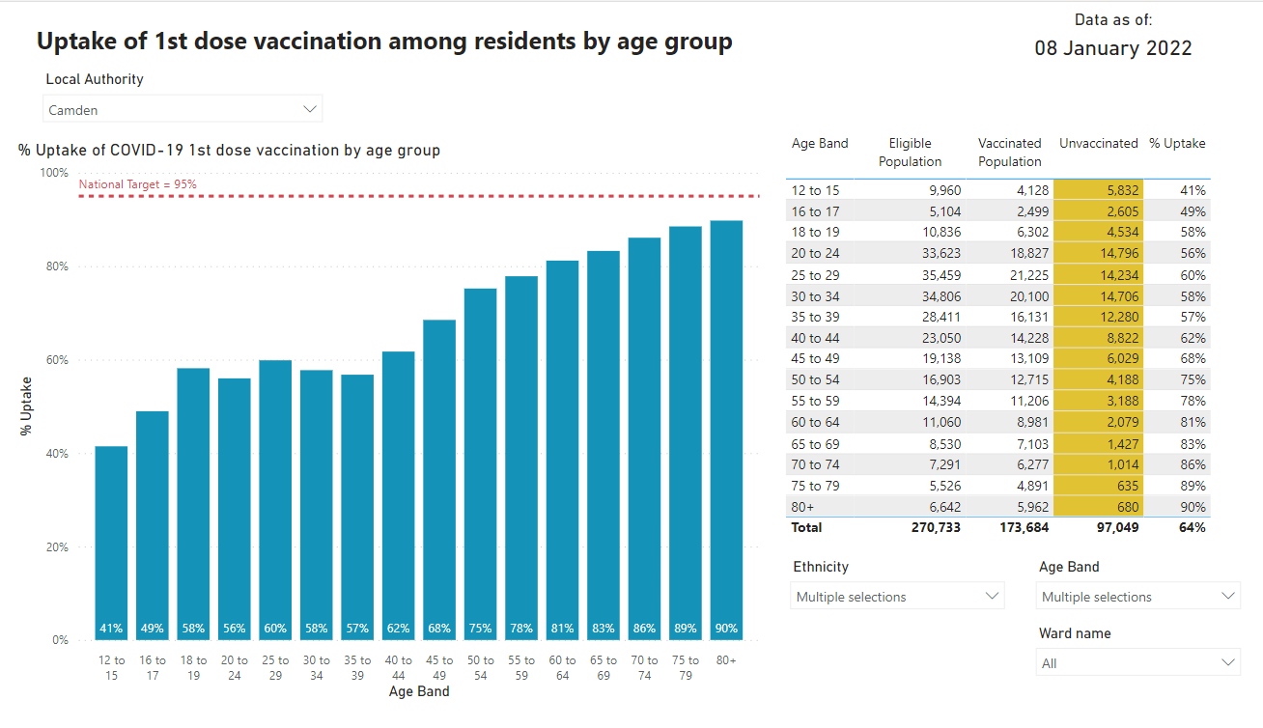
Source: PHE COVID19 situational awareness portal

Slide 3
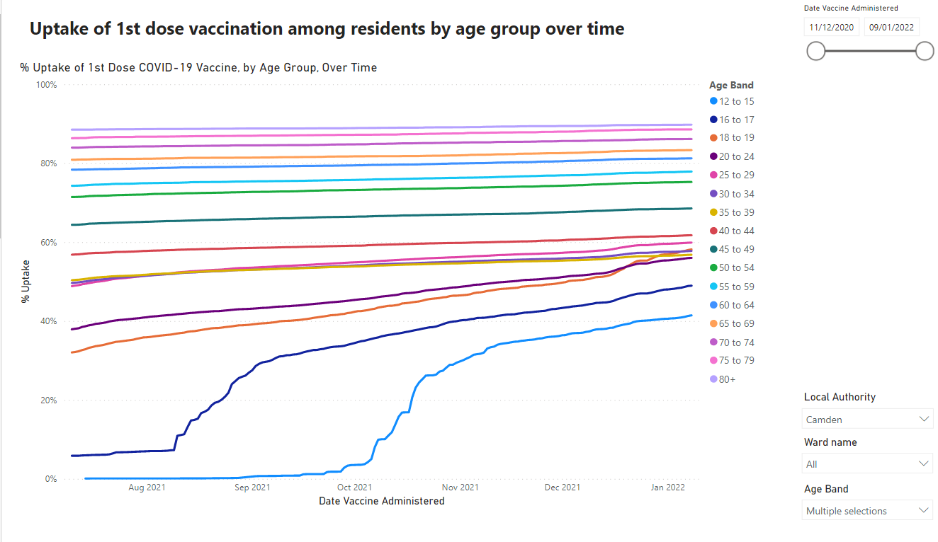
PHE COVID19 Situational awareness portal 8th of January 2022

Slide 4
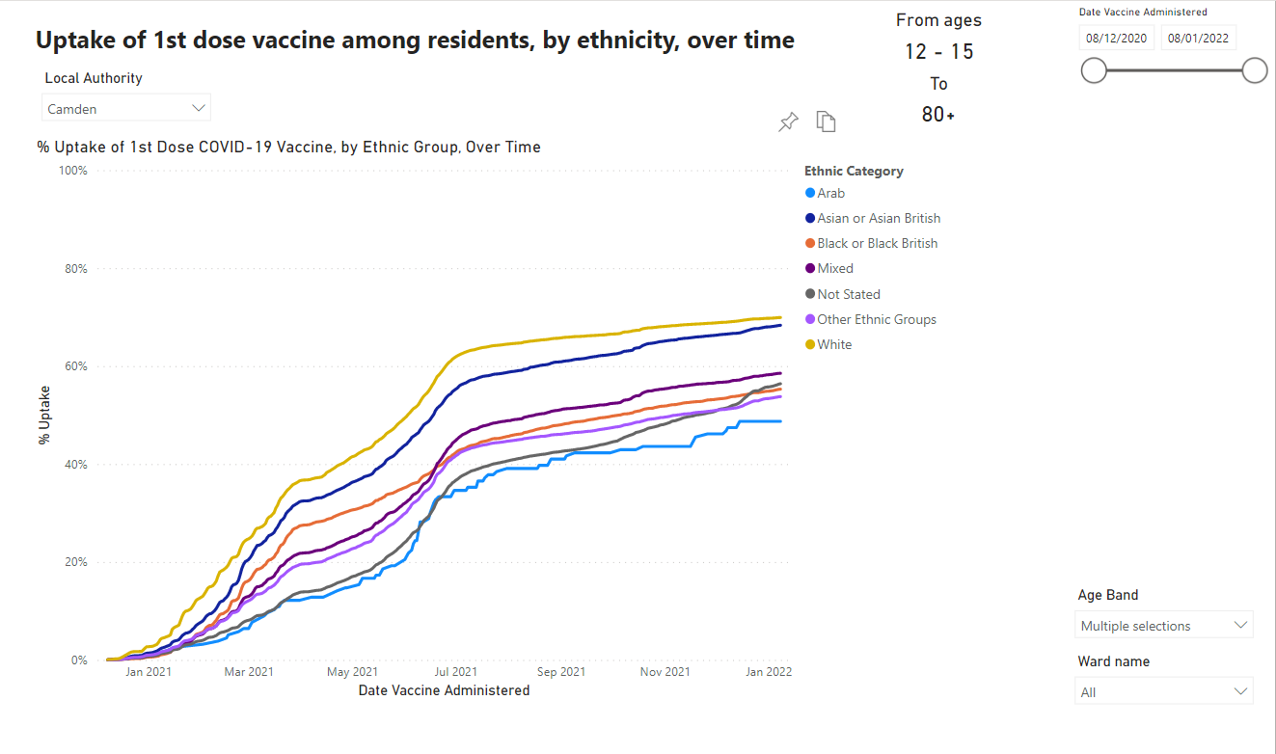

Slide 5
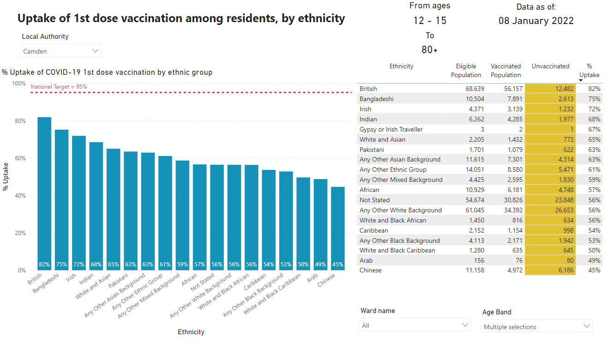
Source: PHE COVID19 situational awareness portal

Slide 6
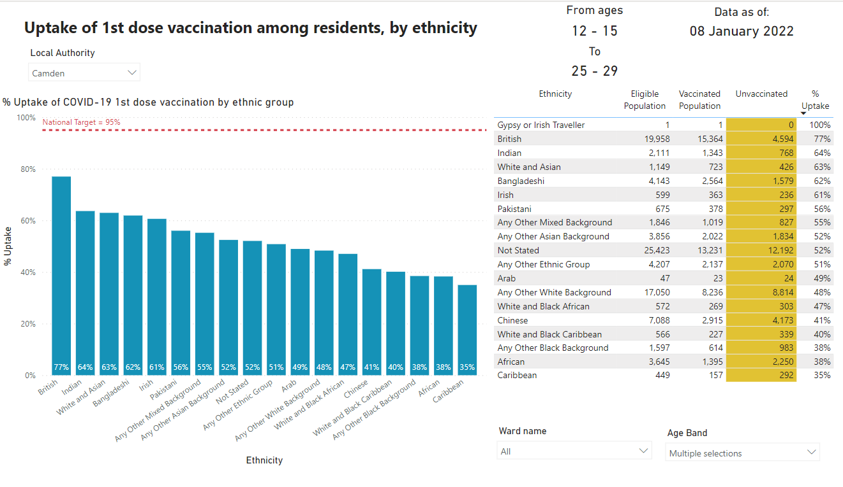

Slide 7
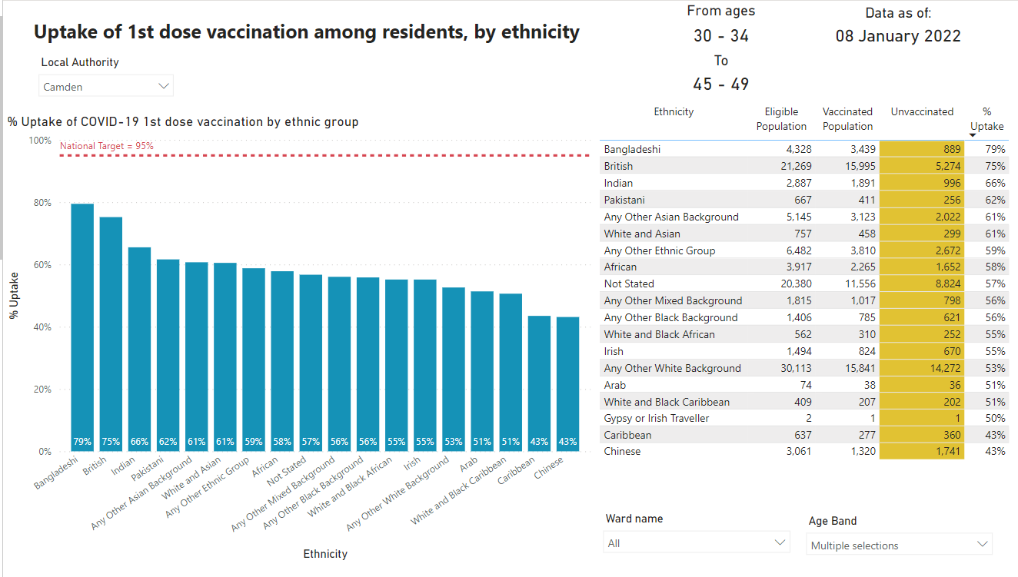

Slide 8
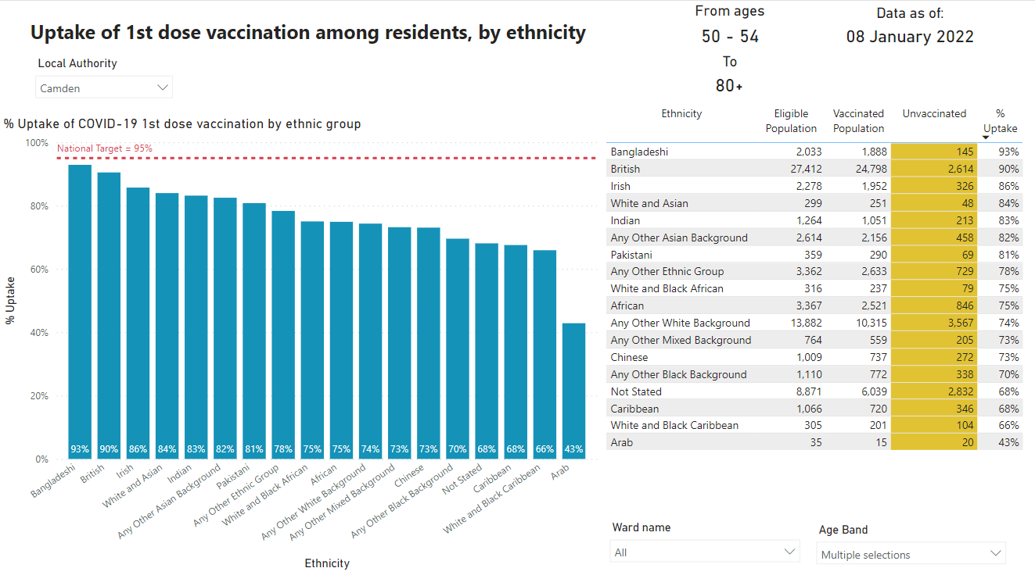

Slide 9
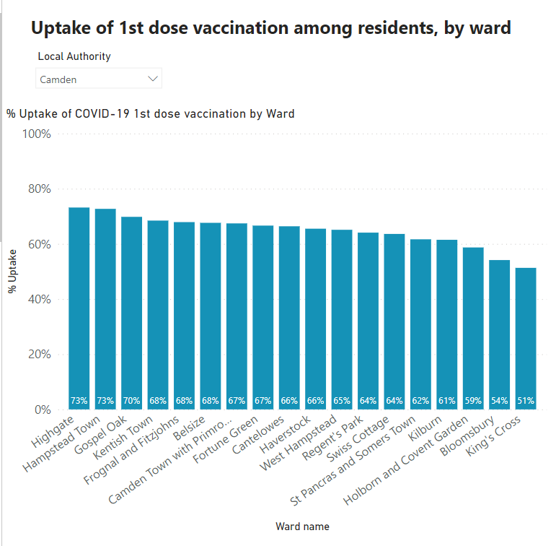
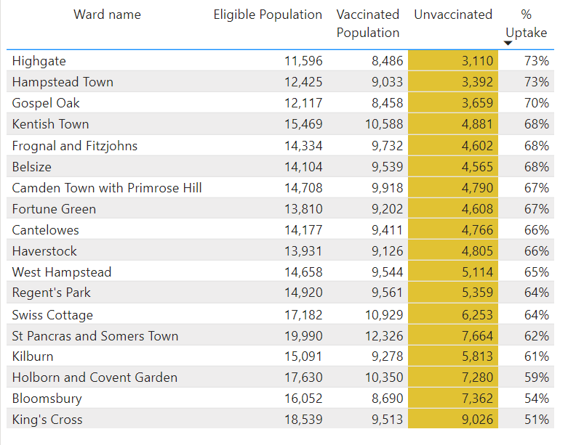
PHE COVID19 Situational awareness portal 8th of January 2022

Slide 10
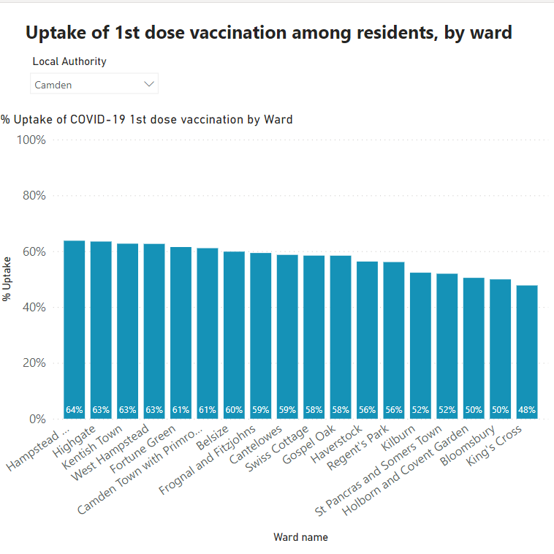
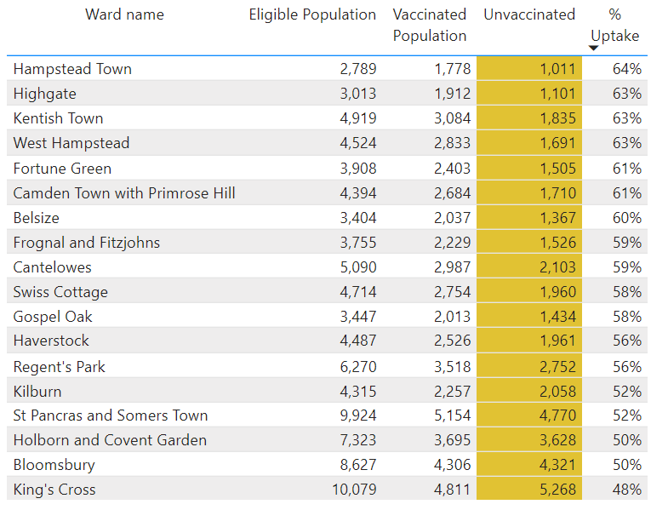
Vaccination uptake of 12-29 year olds by ward

Slide 11
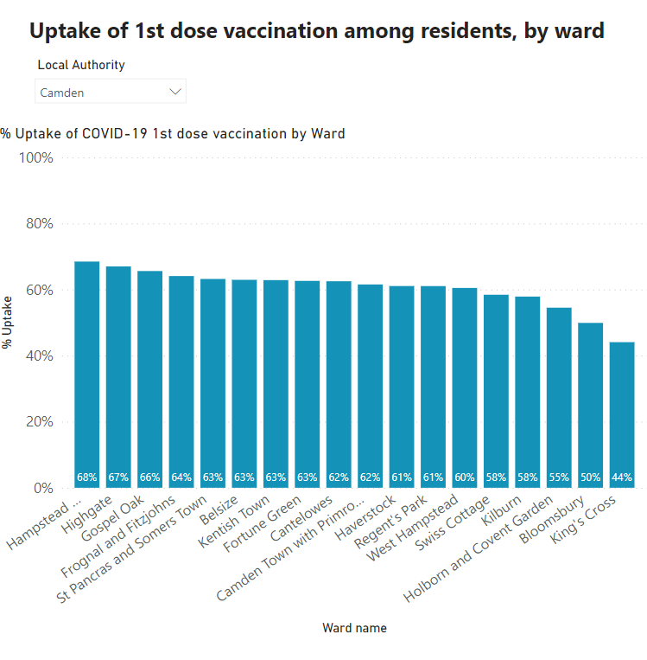
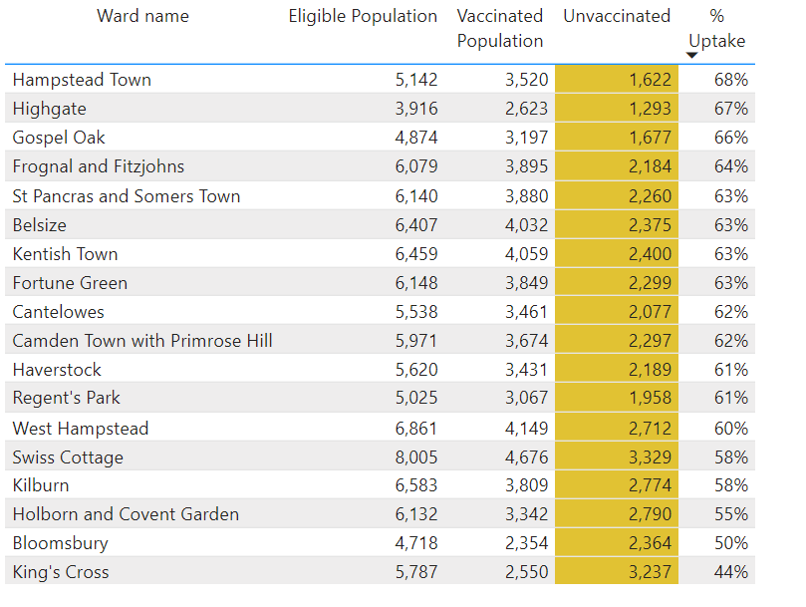
Vaccination uptake of 30-49 year olds by ward

Slide 12
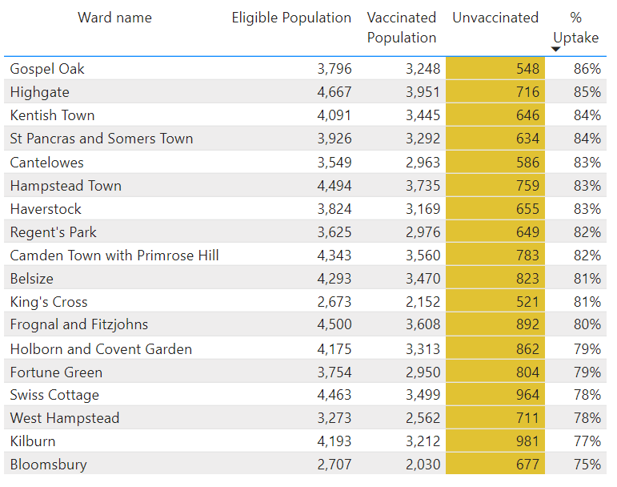
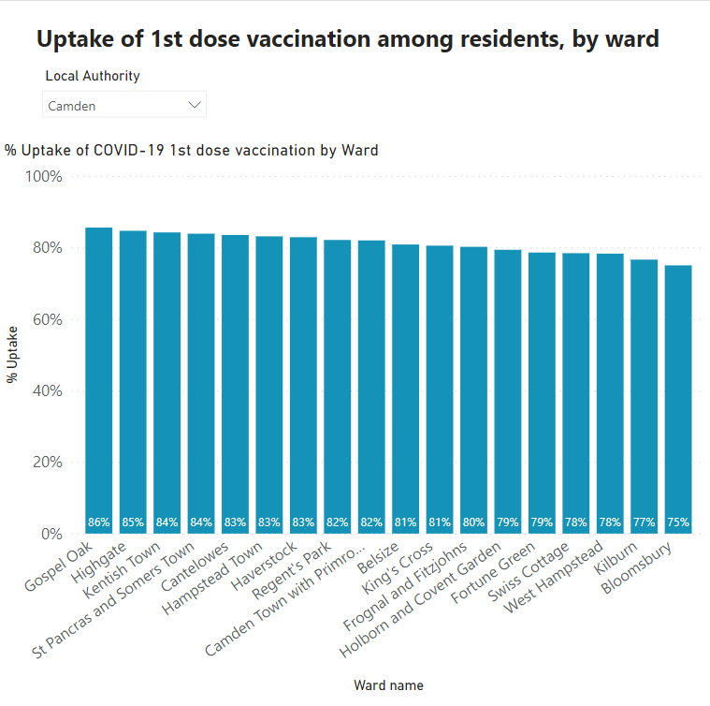
Vaccination uptake of 50+ year olds by ward

Slide 13
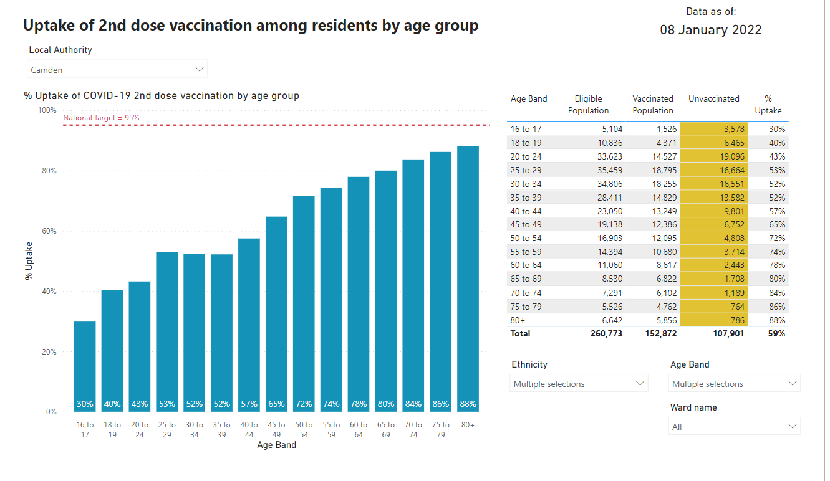
PHE COVID19 Situational awareness portal 8th of January 2022
Source: PHE COVID19 situational awareness portal

Slide 14
First and second Covid19 dose; vulnerable groups
Priority group | Overall uptake 1st Dose | Overall uptake 2nd Dose
Pregnant women | 68.6% | 61.3%
Learning disability | 73.0% | 66.2%
Severe Mental illness | 75.5% | 70.5%

Slide 15
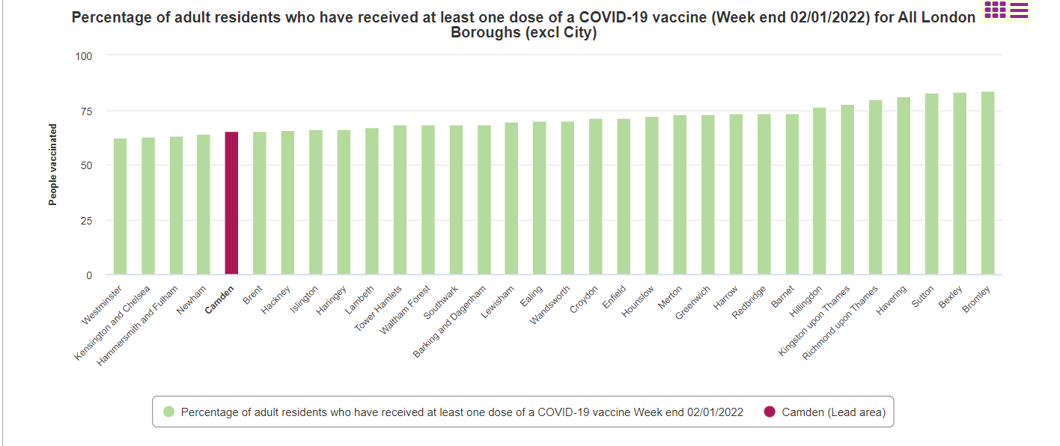
65.27% of Camden residents aged 18 and over have received 1st dose of COVID19 Vaccine
Source: UK Government, Coronavirus (COVID-19) in the UK

Slide 16
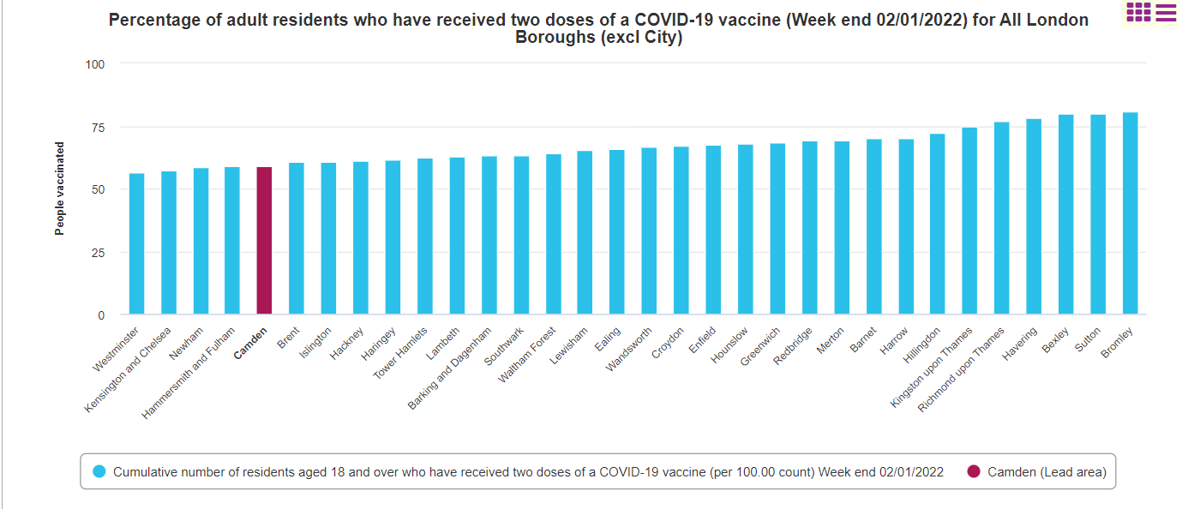
59.15% of Camden residents aged 16 and over have received two doses of COVID19 Vaccine
Source: UK Government, Coronavirus (COVID-19) in the UK

Slide 17
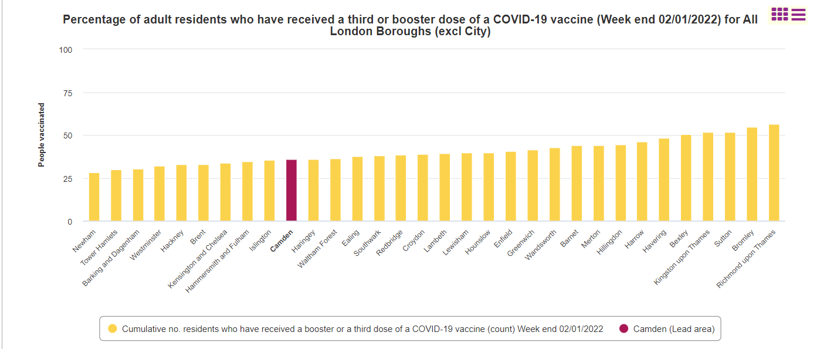
35.97% of Camden residents aged 18 and over have received two doses of COVID19 Vaccine

