Slide 1
Cost of Living Crisis Survey Analysis

Slide 2
Purpose
VAC put together a survey to help understand how community organisations are responding to the Cost of Living Crisis, how it is impacting their organisation and what further support they need to tackle this new challenge.
We heard from 50 of our members and service users.

Slide 3
Impact of the Cost-of-Living Crisis on Community Organisation’s Ability to Deliver Services

Slide 4
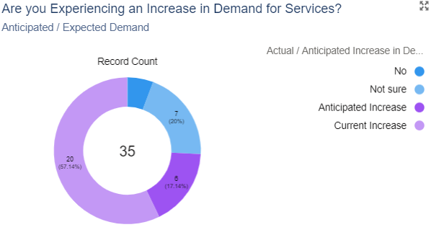
Impact on Service Delivery – Demand for Services
Notes:
Anticipated vs. expected
Majority are seeing this already or anticipate this happening

Slide 5
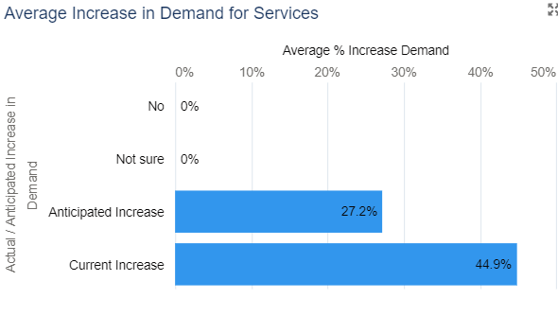
Impact on Service Delivery – Increase in Demand
Notes:
This represents average increase.
In reality, actual increase in some cases has been reported as high as 100%

Slide 6
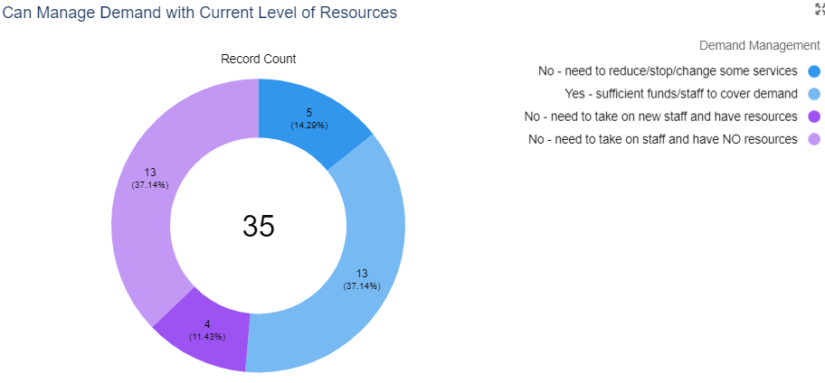
Impact on Service Delivery – Demand Management
Notes:
“people are living in extreme poverty. they can not turn their light on in order to save energy. They use street lights. Recently we have issued 100 food bank vouchers for people who are facing starvation. The demand is continuing but we have no resources.”

Slide 7
Impact on Ability to Deliver Services– Key Themes
Marked increase in demand for services with many service users struggling
Concerns of how current staff and volunteers will manage current or new services developed to help response to Crisis
Increasingly hard to retain and sustain workforce, as well as recruit new staff and employees
Having to focus on ‘critical’ rather than ‘preventative’ cases, or reduce or cutback on services that are now deemed ‘less priority’
Rising rent and running costs are stretching tight budgets even further
Reduction in income for organisation for chargeable services e.g. room hire, membership etc.
Notes:
“we would like to support our community by providing a warm hub, but our church heating costs and food costs are going to make that very difficult”
“cost of living crisis is causing more of our supporters to no longer have the funds to pay for membership - so reduction in income from which we usually pay for services to targeted beneficiaries.”
Vicarious trauma - signifies the ways that an individual's resilience, experiences, support, and coping strategies manage the traumatic material, not that it has no effect.

Slide 8
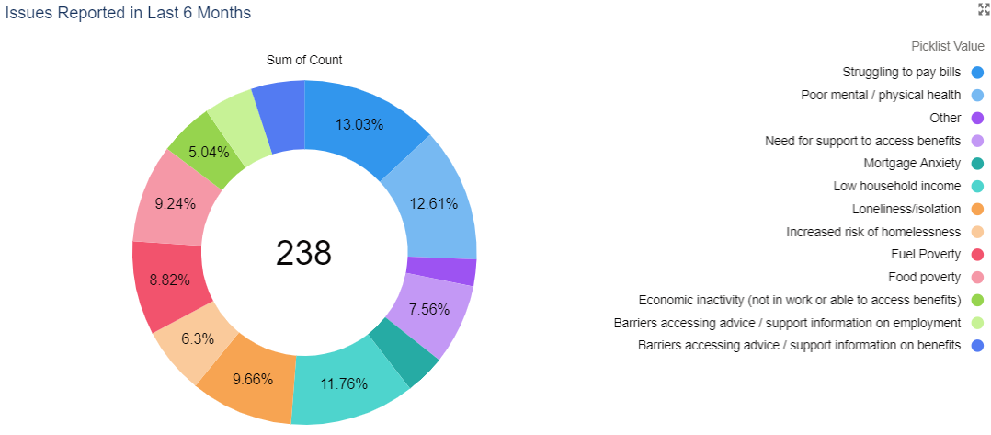
Impact on Ability to Deliver Services: Issues Reported
Notes:
Other issues include Increase in domestic violence and Digital divide making it harder to find work or having a 1-2-1 person to talk to.
“Young people have expressed their mental health is affected. They are choosing to drop out of education or defer. Their are havingto make difficult choices and it’s leading to social isolation and in some instances affecting their relationships (with friends and family) “

Slide 9
Change in Issues Reported since the Crisis and how this Differs from the Pandemic
“Increases in anxiety, stress and mental health as service users grapple with Crisis reporting a multitude of issues and concerns”
People from all backgrounds are struggling with cost of living and food insecurity.
“Services users are increasingly unable to find support from statutory services and are turning to us more. They report knocking on closed doors to services”
“Very different demographic accessing Foodbank now. A lot of working households do not have enough to live on now. Struggling with debt after massive increases in utility bills”.
“The number of women/ young people approaching us for help has increased dramatically”.
“Difficult choices around further education, social isolation, loss of social/ exclusion from fun or enjoyable activities. Burden to support family financially”
Notes:
“Additional people are already coming to access our services - requiring regular food bank vouchers. Also additional people are accessing us with severe mental health issues. We anticipate an increased demand for support over the Christmas period”
“More people in poverty who do not know how to access the addition help available. Many people on dialysis worried about power cuts during treatment”
“Our clients are from a vulnerable population but the cost of living crisis has put additional stress on the ability to purchase food, heat and attend services. This has had a knock on impact on both mental and physical health.”
Dovetails with what we are seeing through social prescribing referrals:
we’re hearing more from residents /referrers who are concerned about finances (fuel bills, rent, food prices, running vital medical equipment etc). It’s similar to the pandemic response, where individuals (middle earners & two income households) that have not needed previous SP support are turning to us for assistance. I’ve spoken with some that are even considering moving out of the borough/London.
Many residents are not aware of the available resources regarding the cost of living, whilst others don’t think there’s enough.
They feel overwhelmed and confused with the information delivered by the council, government, energy firms and even media, suggesting there needs to be more clarity. This was highlighted when I joined Henna’s women group and talked about how Community Links can help and Camden’s Hardship fund. The attendees were oblivious of the scheme, and all requested to be referred for the grant.
With the impending long winter and festive period many households will find it a challenge, sadly some may have to choose between heating and eating. This will no doubt add to those who are already struggling with existing issues (MH, debt, long- term conditions etc) and represents a risk of starting starting for others.

Slide 10
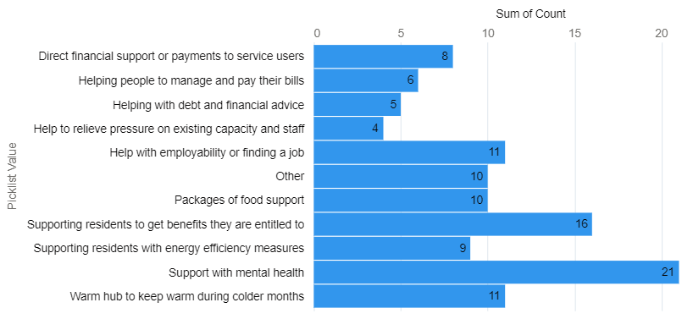
Services being Setup Specifically for Crisis

Slide 11
Plans to Help Mitigate Impact of Cost of Living Crisis
Apply / raise more funding to continue providing or develop new services/ staff/ running costs
Increase capacity to accommodate growing needs
Emergency payments /Cooking hot meals or providing food support
Try to keep service costs free or minimal
Providing more information and advice for residents
Setting up warm hubs and social opportunities
Notes:
Systematic and Strategic partnerships with funders and statutory organisations on top of adequate funding. We have the space, we need staff or money to get the staff in.

Slide 12
Resources Needed to Deliver Services
Financial support and funding to support service users
Financial support and funding for running costs
Information and resources
More staff, volunteers, training
Technical / IT support
Support for staff – financial and well being
Free or affordable space
Notes:
Google Grant and room hire directory

Slide 13
Impact of the Cost-of-Living Crisis on Community Organisations’ Overall Approach and Strategy

Slide 14
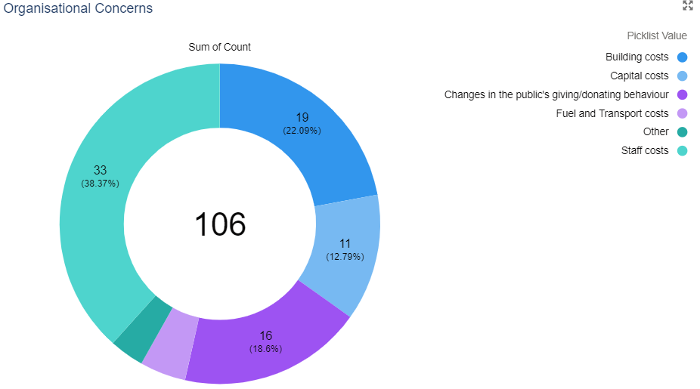
Impact on Organisations: Organisational Concerns
Notes:
Utilities – gas, electricity, water
Salaries and associated costs
Staff recruitment, retention and wellbeing
Building costs – including rent and insurance
Fuel and Transport costs – including travel or vehicles your organisation owns or rents
Capital costs – including buying equipment e.g. computers
Changes in the public's giving/donating behaviour
Other

Slide 15
Board and Managerial Response to Address Concerns
Revise funding and income generation strategy
Consider Cost of Living extra payment / pay rise to support staff
Ensuring that the building and utilities are used appropriately
Revise business plans and how to prioritise / develop new services
Speak to funders and council for support
More networking and partnership working

Slide 16
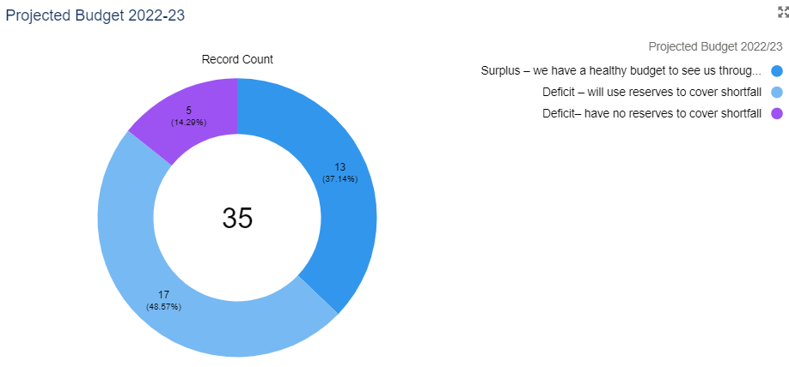
Impact on Organisations: Projected Budget 2022-23

Slide 17
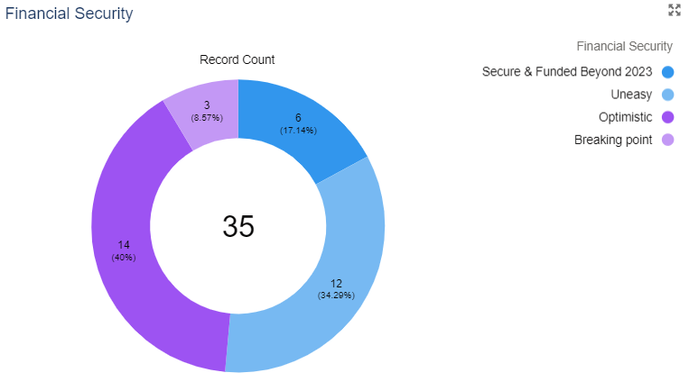
Impact on Organisations: Financial Security
Notes:
Breaking point – without additional resource and support we will need to reduce our services or close by March 2023
Uneasy - our current funding pipeline will sustain our services until March 2023 but beyond that we are not sure
Optimistic - our current funding pipeline will sustain our services until March 2023 and we are confident we will secure additional funding to continue beyond 2023
Secure – we already have funding and resources in place to secure all our services beyond March 2023

Slide 18
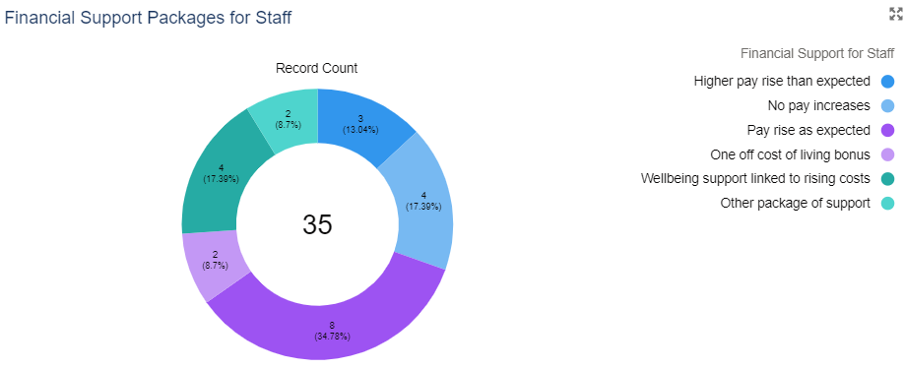
Impact on Organisations: Financial Measures for Staff

Slide 19
Impact on Organisations: Support Needed
More money – grants, donations, longer term
Information & signposting to resources and opportunities
Networking, collaboration and partnership opportunities
Collective “voice” in campaigning and lobbying
Support recruiting and retaining staff and volunteers
Guidance and support on managing office space and premises

Slide 20
Impact on Organisations: Ideas to Address Challenges
Better Connections to local partners and institutions.
Political pressure needs to be applied. Campaigning to save our vital services
Learn from each other, develop case studies to support organisations
increased training for staff to work with escalating numbers of people with mental health challenges, at risk of suicide etc
More targeted financial support for vulnerable communities or those on the margins
Notes:
“ think the voluntary sector is ready and willing to support people in need, but it really does need Government/Council support and intervention. This crisis is unique because not only is it being faced by our beneficiaries, but also all our staff and Trustees who are also concerned about rising costs and fuel bills. So, I am very worried about local people, communities and my team especially with the cold months setting in.”
More support needs to be given to those who are on very low incomes but fall just outside the benefit threshold. This could involve council tax relief/exemption and means-tested access to food banks
“Camden is a divided borough and there is a risk of this getting worse as we increasingly have to rely on donations from community members. Rather than mutual/ neighbourhood wide model (for example a time/ skills bank) we are in a situation where some people give to foodbanks and some people use them. While a necessity this has risks of widening the gap. We need more understanding of the issues so as we can tackle them at source (not keep sticky plastering over them)”

Slide 21
Thank you
Email
www.vac.org.uk

